Slide 1
JEM-EUSO and pathfinders
Observation of ultra-high-energy cosmic rays from space
Etienne Parizot
(APC – Université Paris Diderot - France)
ONR-APC-IPGP meeting — 29th October 2014

Slide 2
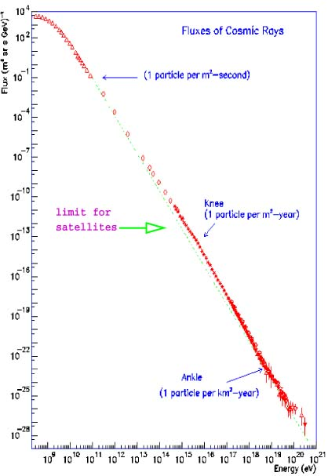
The cosmic ray energy spectrum
Flux
~ 1 particle/m²/second
~ 1 particle/m²/year
10²¹ eV
~ 1 particle/m²/billion year!
Ultra-high-energy cosmic rays (UHECRs)
100 MeV
Energy

Slide 3
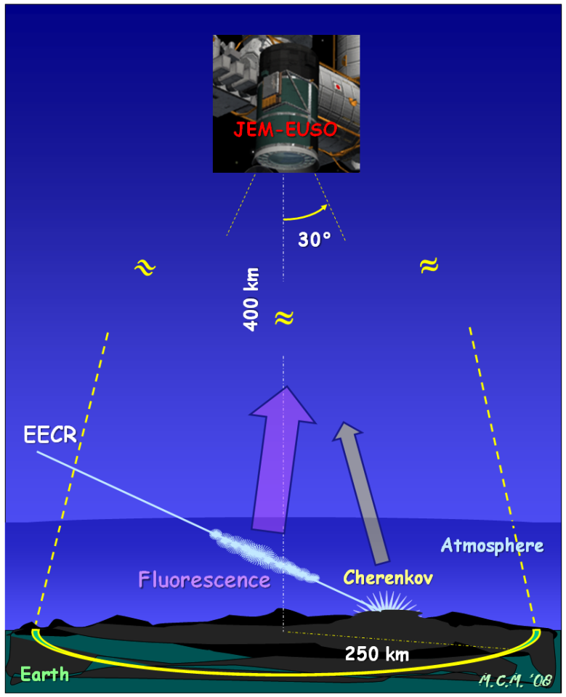
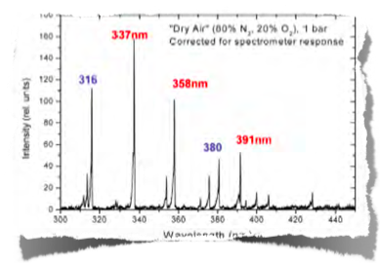
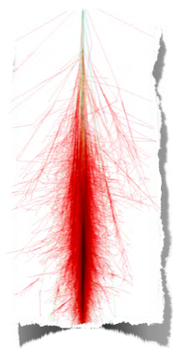
How JEM-EUSO works
Detect UHECR-induced showers through the fluorescence light generated in the atmosphere
1 cosmic ray
UV fluorescence spectrum
~100 billion particles!
“extensive air shower”

Slide 4
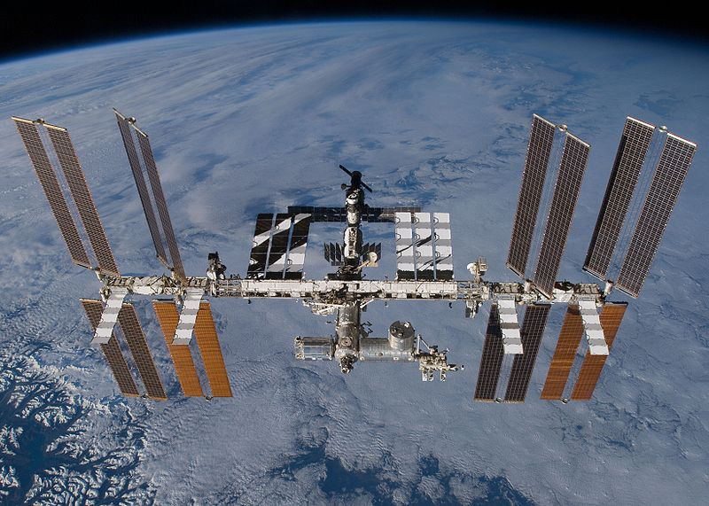
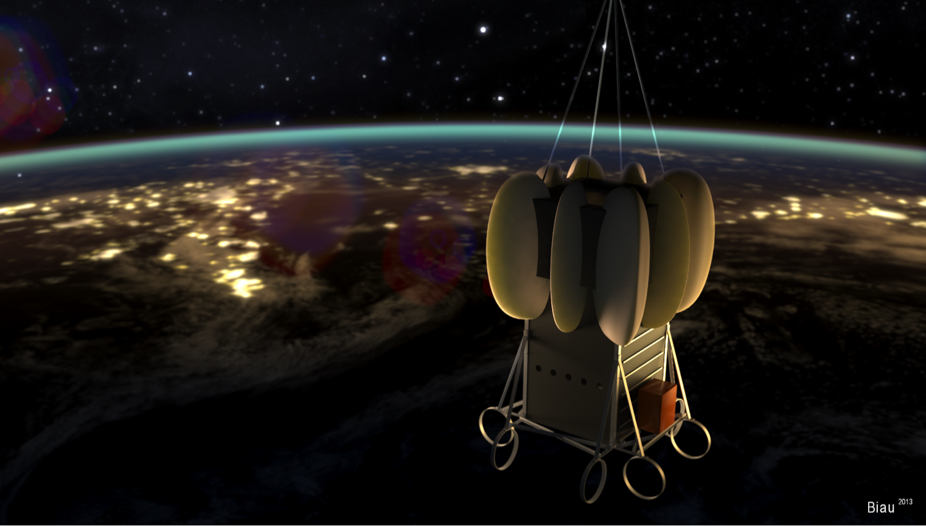
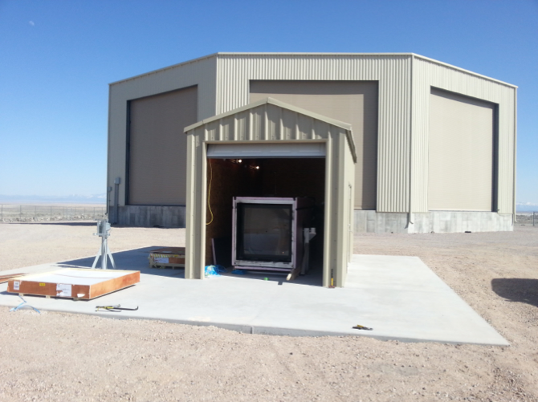
JEM-EUSO and its pathfinders…
EUSO-Balloon
(+ KLYPVE-EUSO)
Mini-EUSO
JEM-EUSO
EUSO-TA (telescope array)

Slide 5
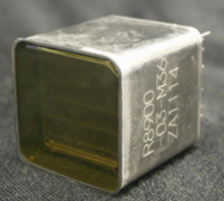
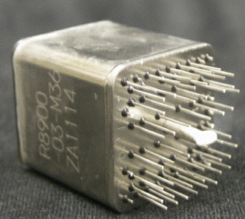
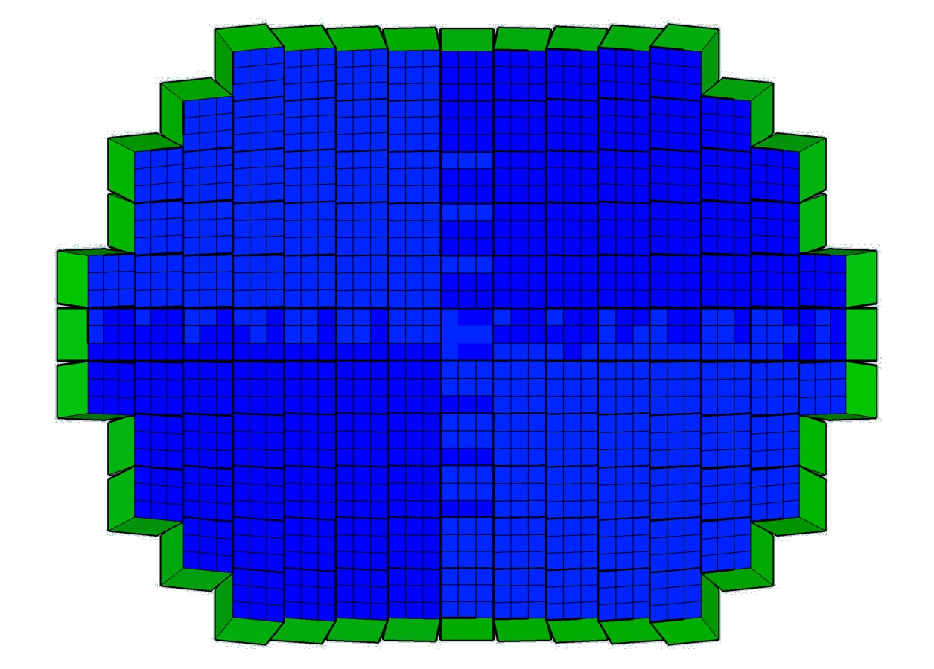
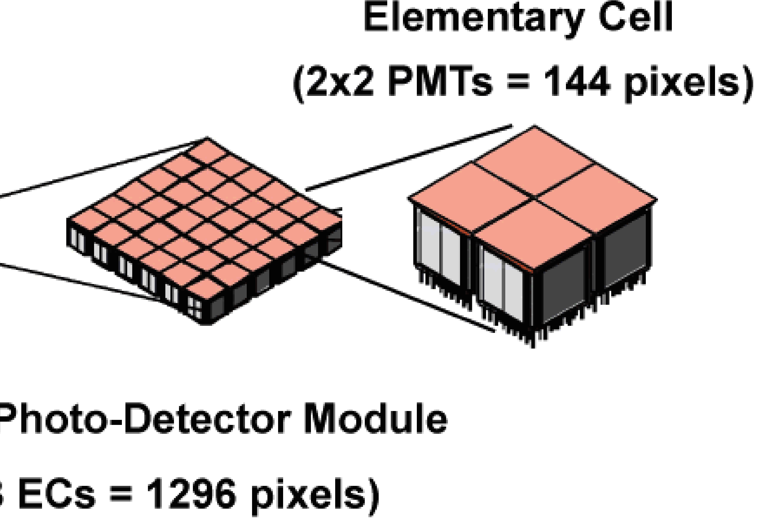
Focal surface
PDM
137 PDM of 9 EC, each EC has 4 PMT with 64 pixels each
4932 PMT and 0.3156 Megapixels

Slide 6
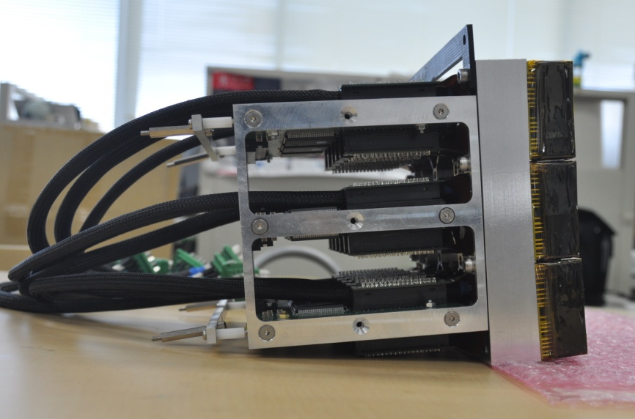
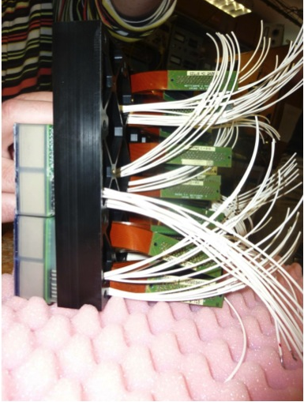
Photo-Detection Module (PDM)

Slide 7
Characteristics and advantages
Huge field of view (60° aperture)
Ultra-sensitive UV camera (single photon counting)
Ultra-fast camera (2.5 µs → 400 000 images/second)
Large dynamic range (automatic gain switches)
Over 300 000 pixels
Full-sky coverage, over several years
+ infrared camera + LIDAR

Slide 8
Many possible synergies
Atmospheric sciences
TLEs (sprites, jets, elves, halos…)
Cloud coverage
Links between cosmic rays and lightning
Airglow (nightglow) monitoring
Sciences of the ocean
Surface bioluminescence
Can a surface water temperature survey (3K accuracy) be useful?
LIDAR reflection → water level?
Meteorites sciences
Statistics, Trajectories, Recovery…
Space debris removal
identification, trajectory → laser shot
Others?
Plant fluorescence…

Slide 9
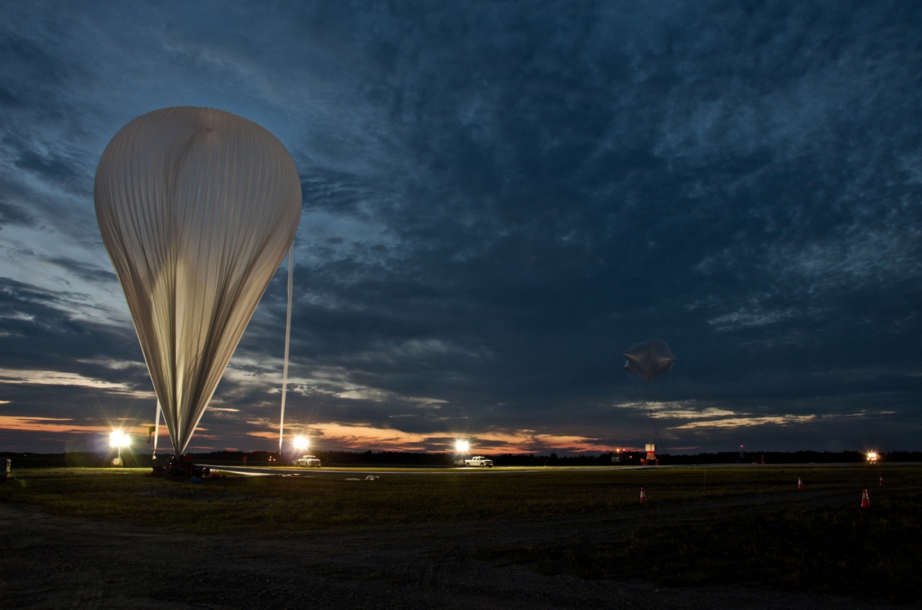
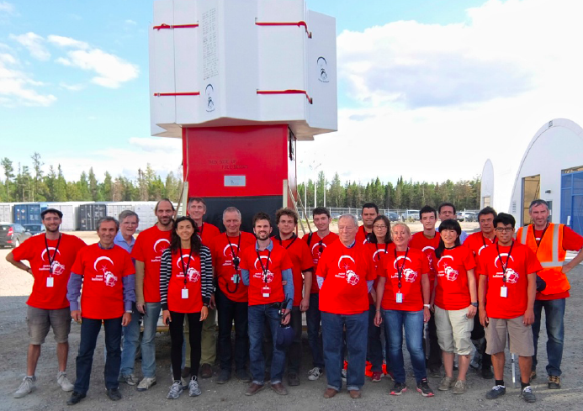
EUSO-Balloon
Pathfinder to JEM-EUSO (CNES mission)
Successful flight on August 24th, 2014 (Timmins, Ontario)

Slide 10
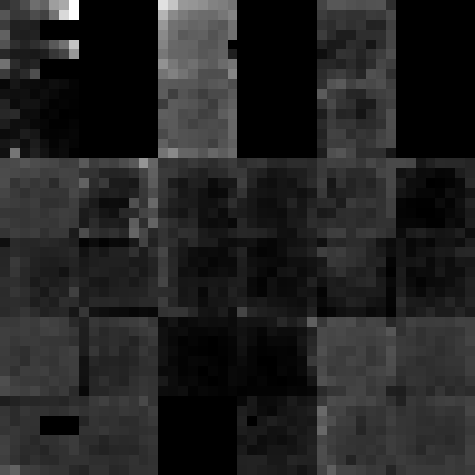
EUSO-Balloon
Pathfinder to JEM-EUSO (CNES mission)
Technology demonstration
Data on the UV background and its space/time variability
• additional to the airglow
• investigation of different types of ground / albedos
Observation of artificial transient events
laser shots + LED + Xenon flashers (US/NASA)

Slide 11
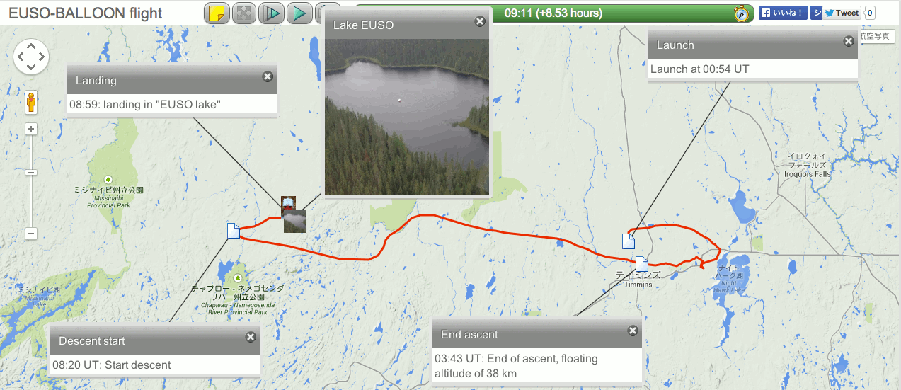
EUSO-Balloon + helicopter

Slide 12
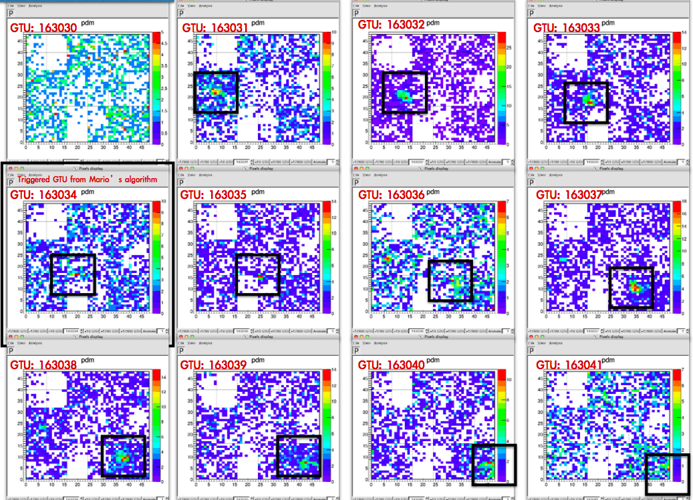
EUSO-Balloon
The data are being analyzed right now!

Slide 13
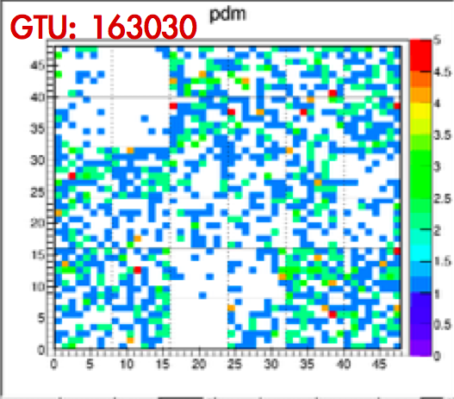
EUSO-Balloon

Slide 14
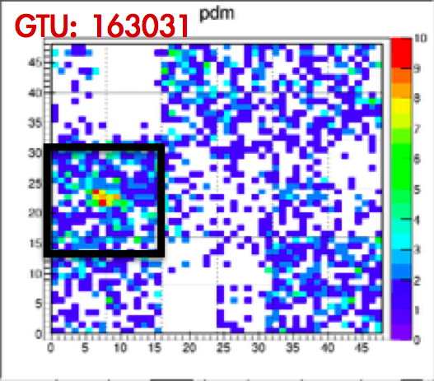
EUSO-Balloon

Slide 15
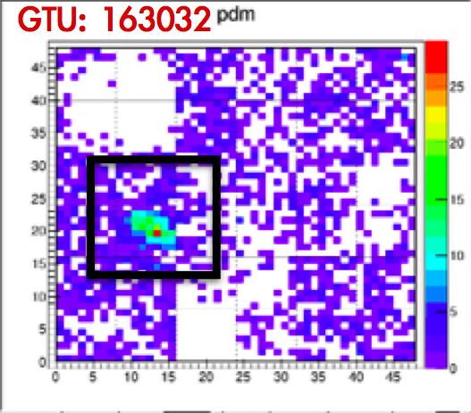
EUSO-Balloon

Slide 16
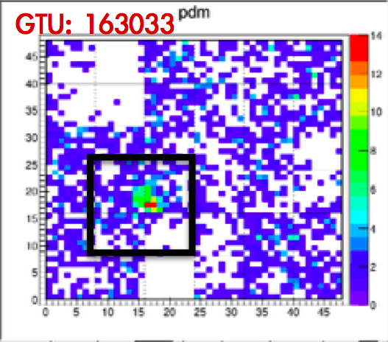
EUSO-Balloon

Slide 17
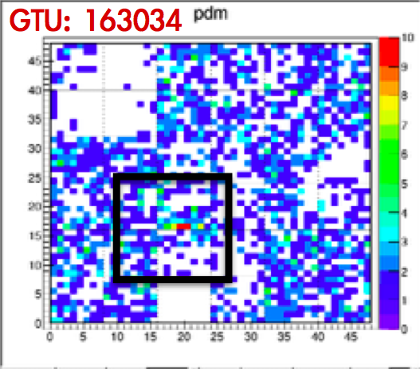
EUSO-Balloon

Slide 18
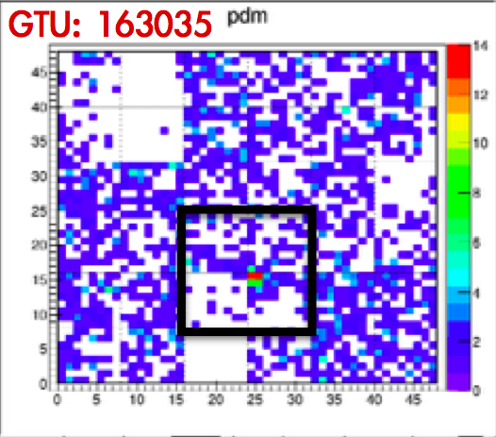
EUSO-Balloon

Slide 19
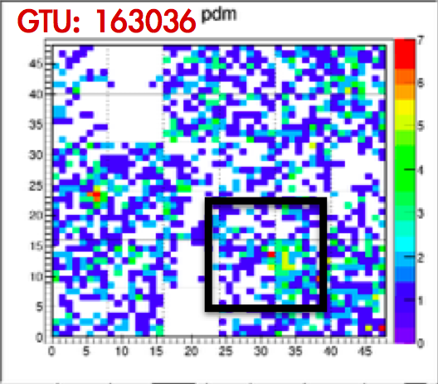
EUSO-Balloon

Slide 20
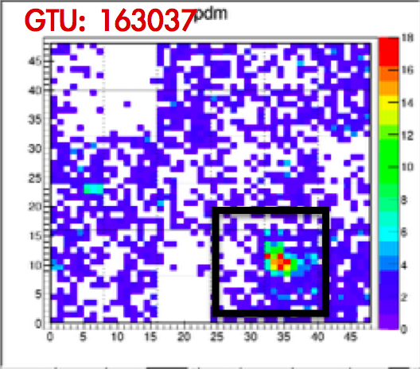
EUSO-Balloon

Slide 21
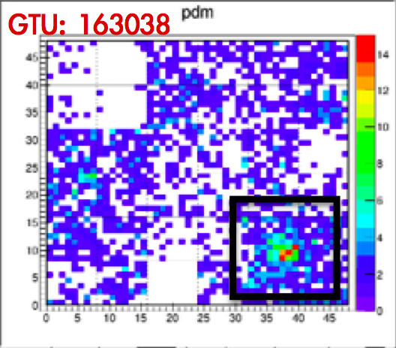
EUSO-Balloon

Slide 22
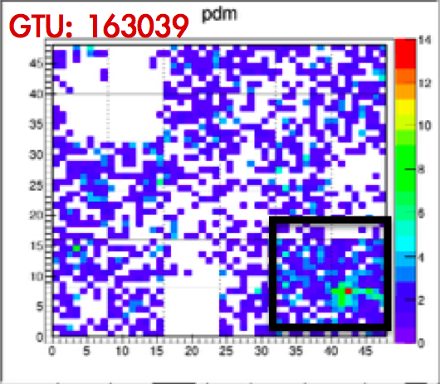
EUSO-Balloon

Slide 23
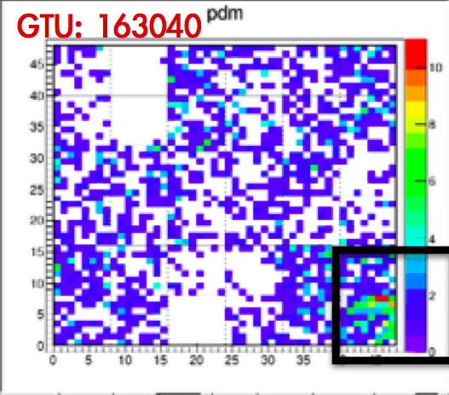
EUSO-Balloon

Slide 24
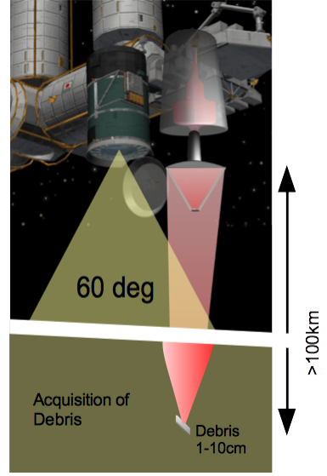
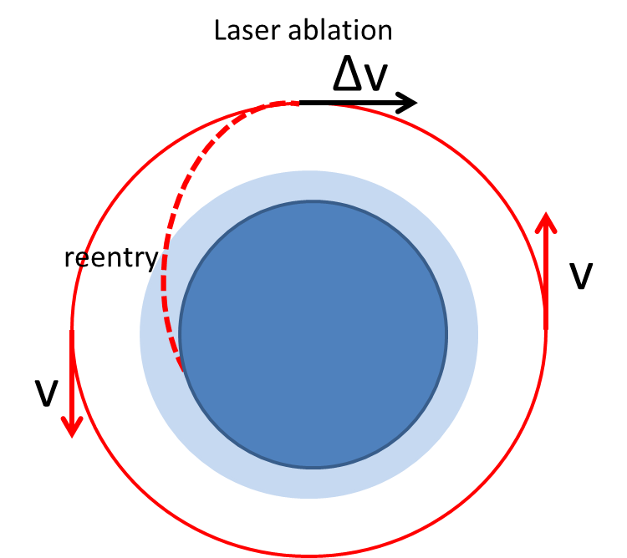
Space debris removal
Strategy
JEM-EUSO can detect and determine the trajectory of debris in the critical 1 cm – 10 cm range!

Slide 25
Next steps
Long duration balloon flight
Expected strong support from both CNES and NASA
Key milestone: detect the first UHECR showers from above (with the fluorescence technique, well established on ground)
Mini-EUSO
Approved mission
ASI (Italian Space Agency) and ROSCOSMOS)
JEM-EUSO demonstrator onboard the ISS (inside, not outside)
Will include test SiPMT detectors
Will observe airglow from space
Will observe TLEs and meteors
Can demonstrate space debris removal strategy
(to be operated in the ISS in 2017)

Slide 26
Thank you!

