Slide 1
JEM-EUSO and pathfinders
Observation of ultra-high-energy cosmic rays from space
Etienne Parizot
(APC – Université Paris Diderot - France)
ONR-APC-IPGP meeting — 29th October 2014

Slide 2
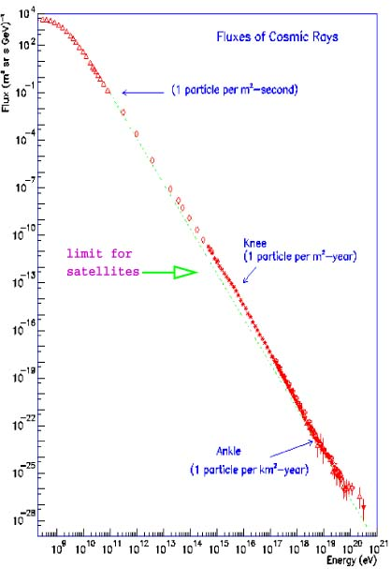
The cosmic ray energy spectrum
Flux
~ 1 particle/m²/second
~ 1 particle/m²/year
10²¹ eV
~ 1 particle/m²/billion year!
Ultra-high-energy cosmic rays (UHECRs)
100 MeV
Energy

Slide 3
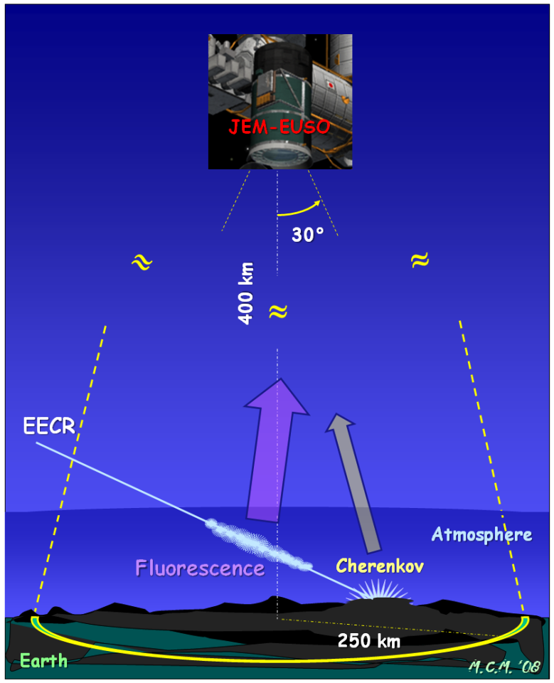
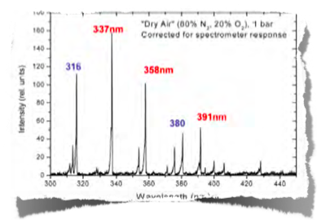
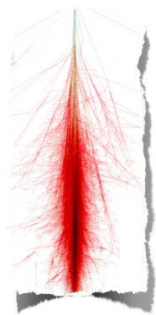
How JEM-EUSO works
Detect UHECR-induced showers through the fluorescence light generated in the atmosphere
1 cosmic ray
UV fluorescence spectrum
~100 billion particles!
“extensive air shower”

Slide 4
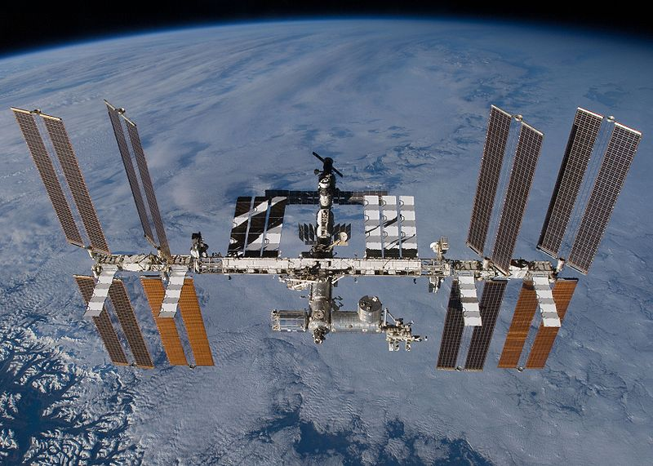
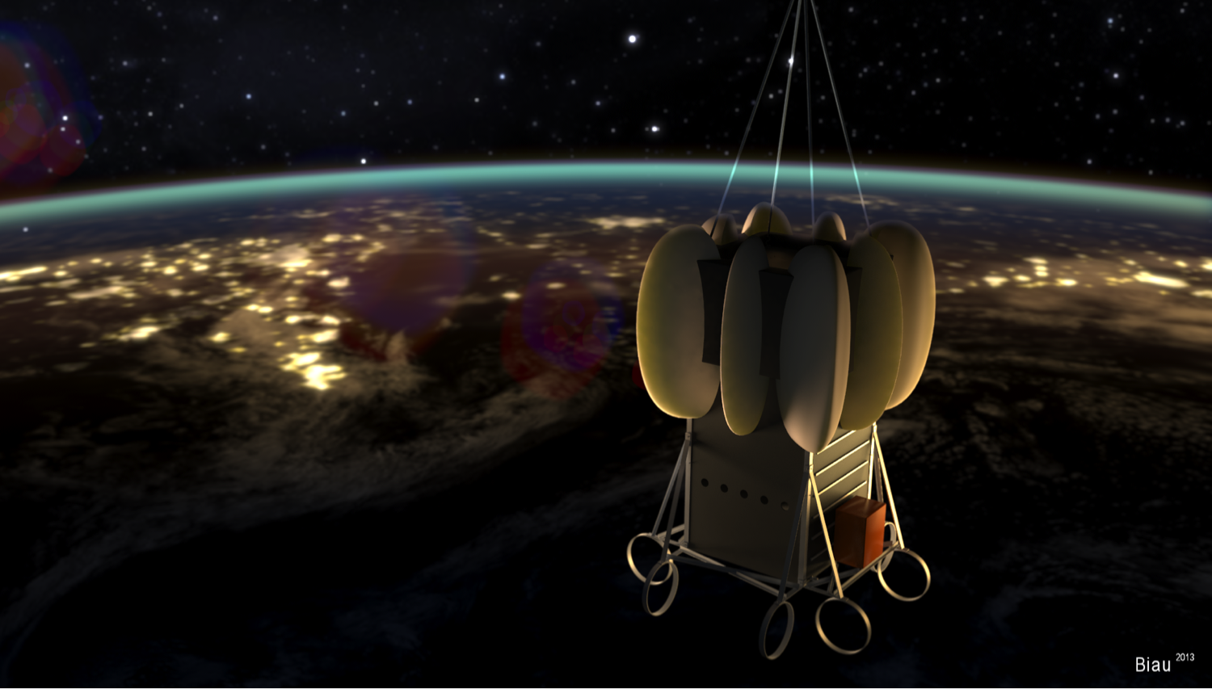
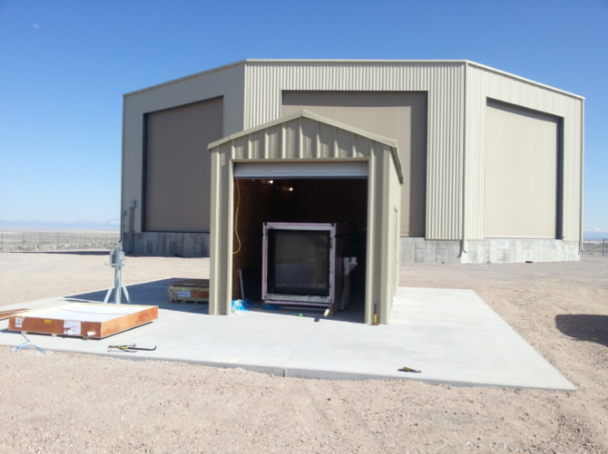
JEM-EUSO and its pathfinders…
EUSO-Balloon
(+ KLYPVE-EUSO)
Mini-EUSO
JEM-EUSO
EUSO-TA (telescope array)

Slide 5
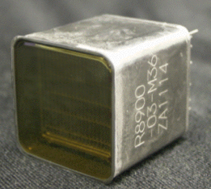
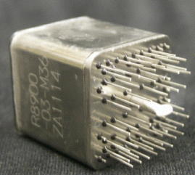
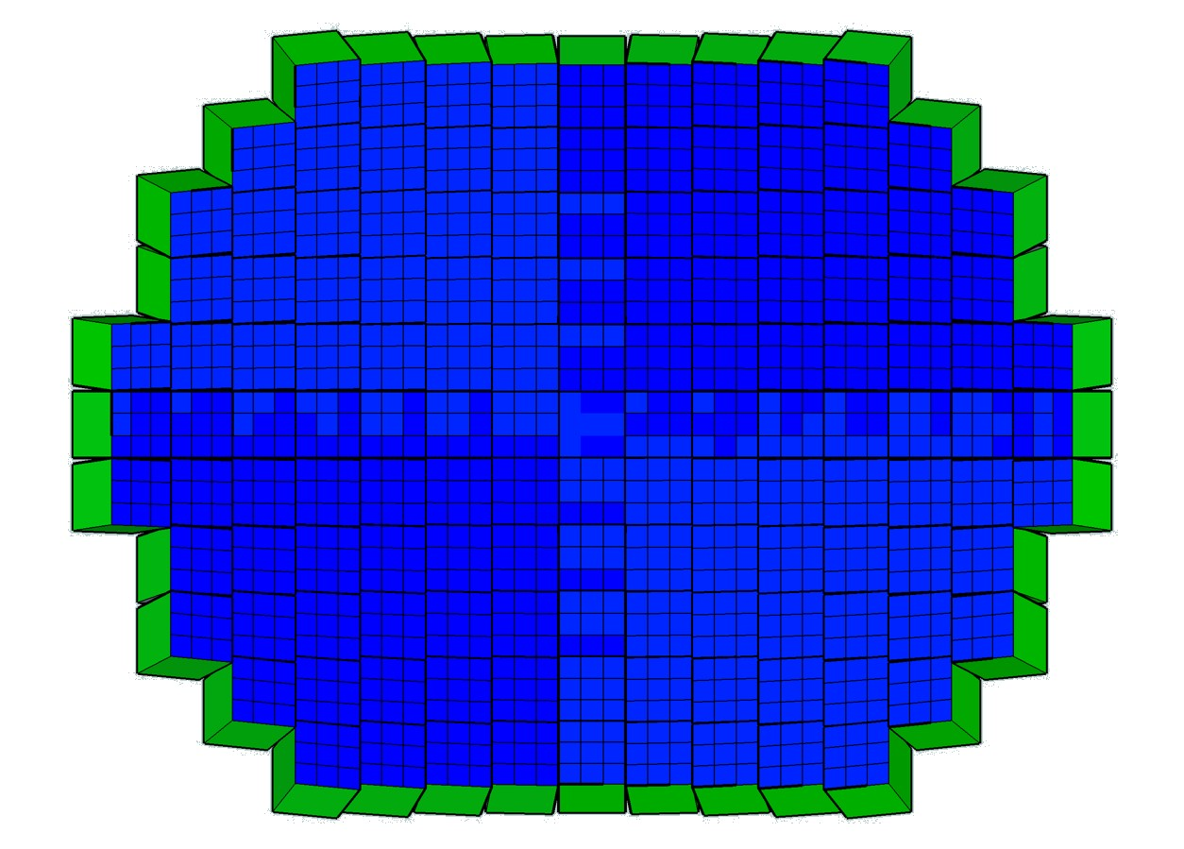
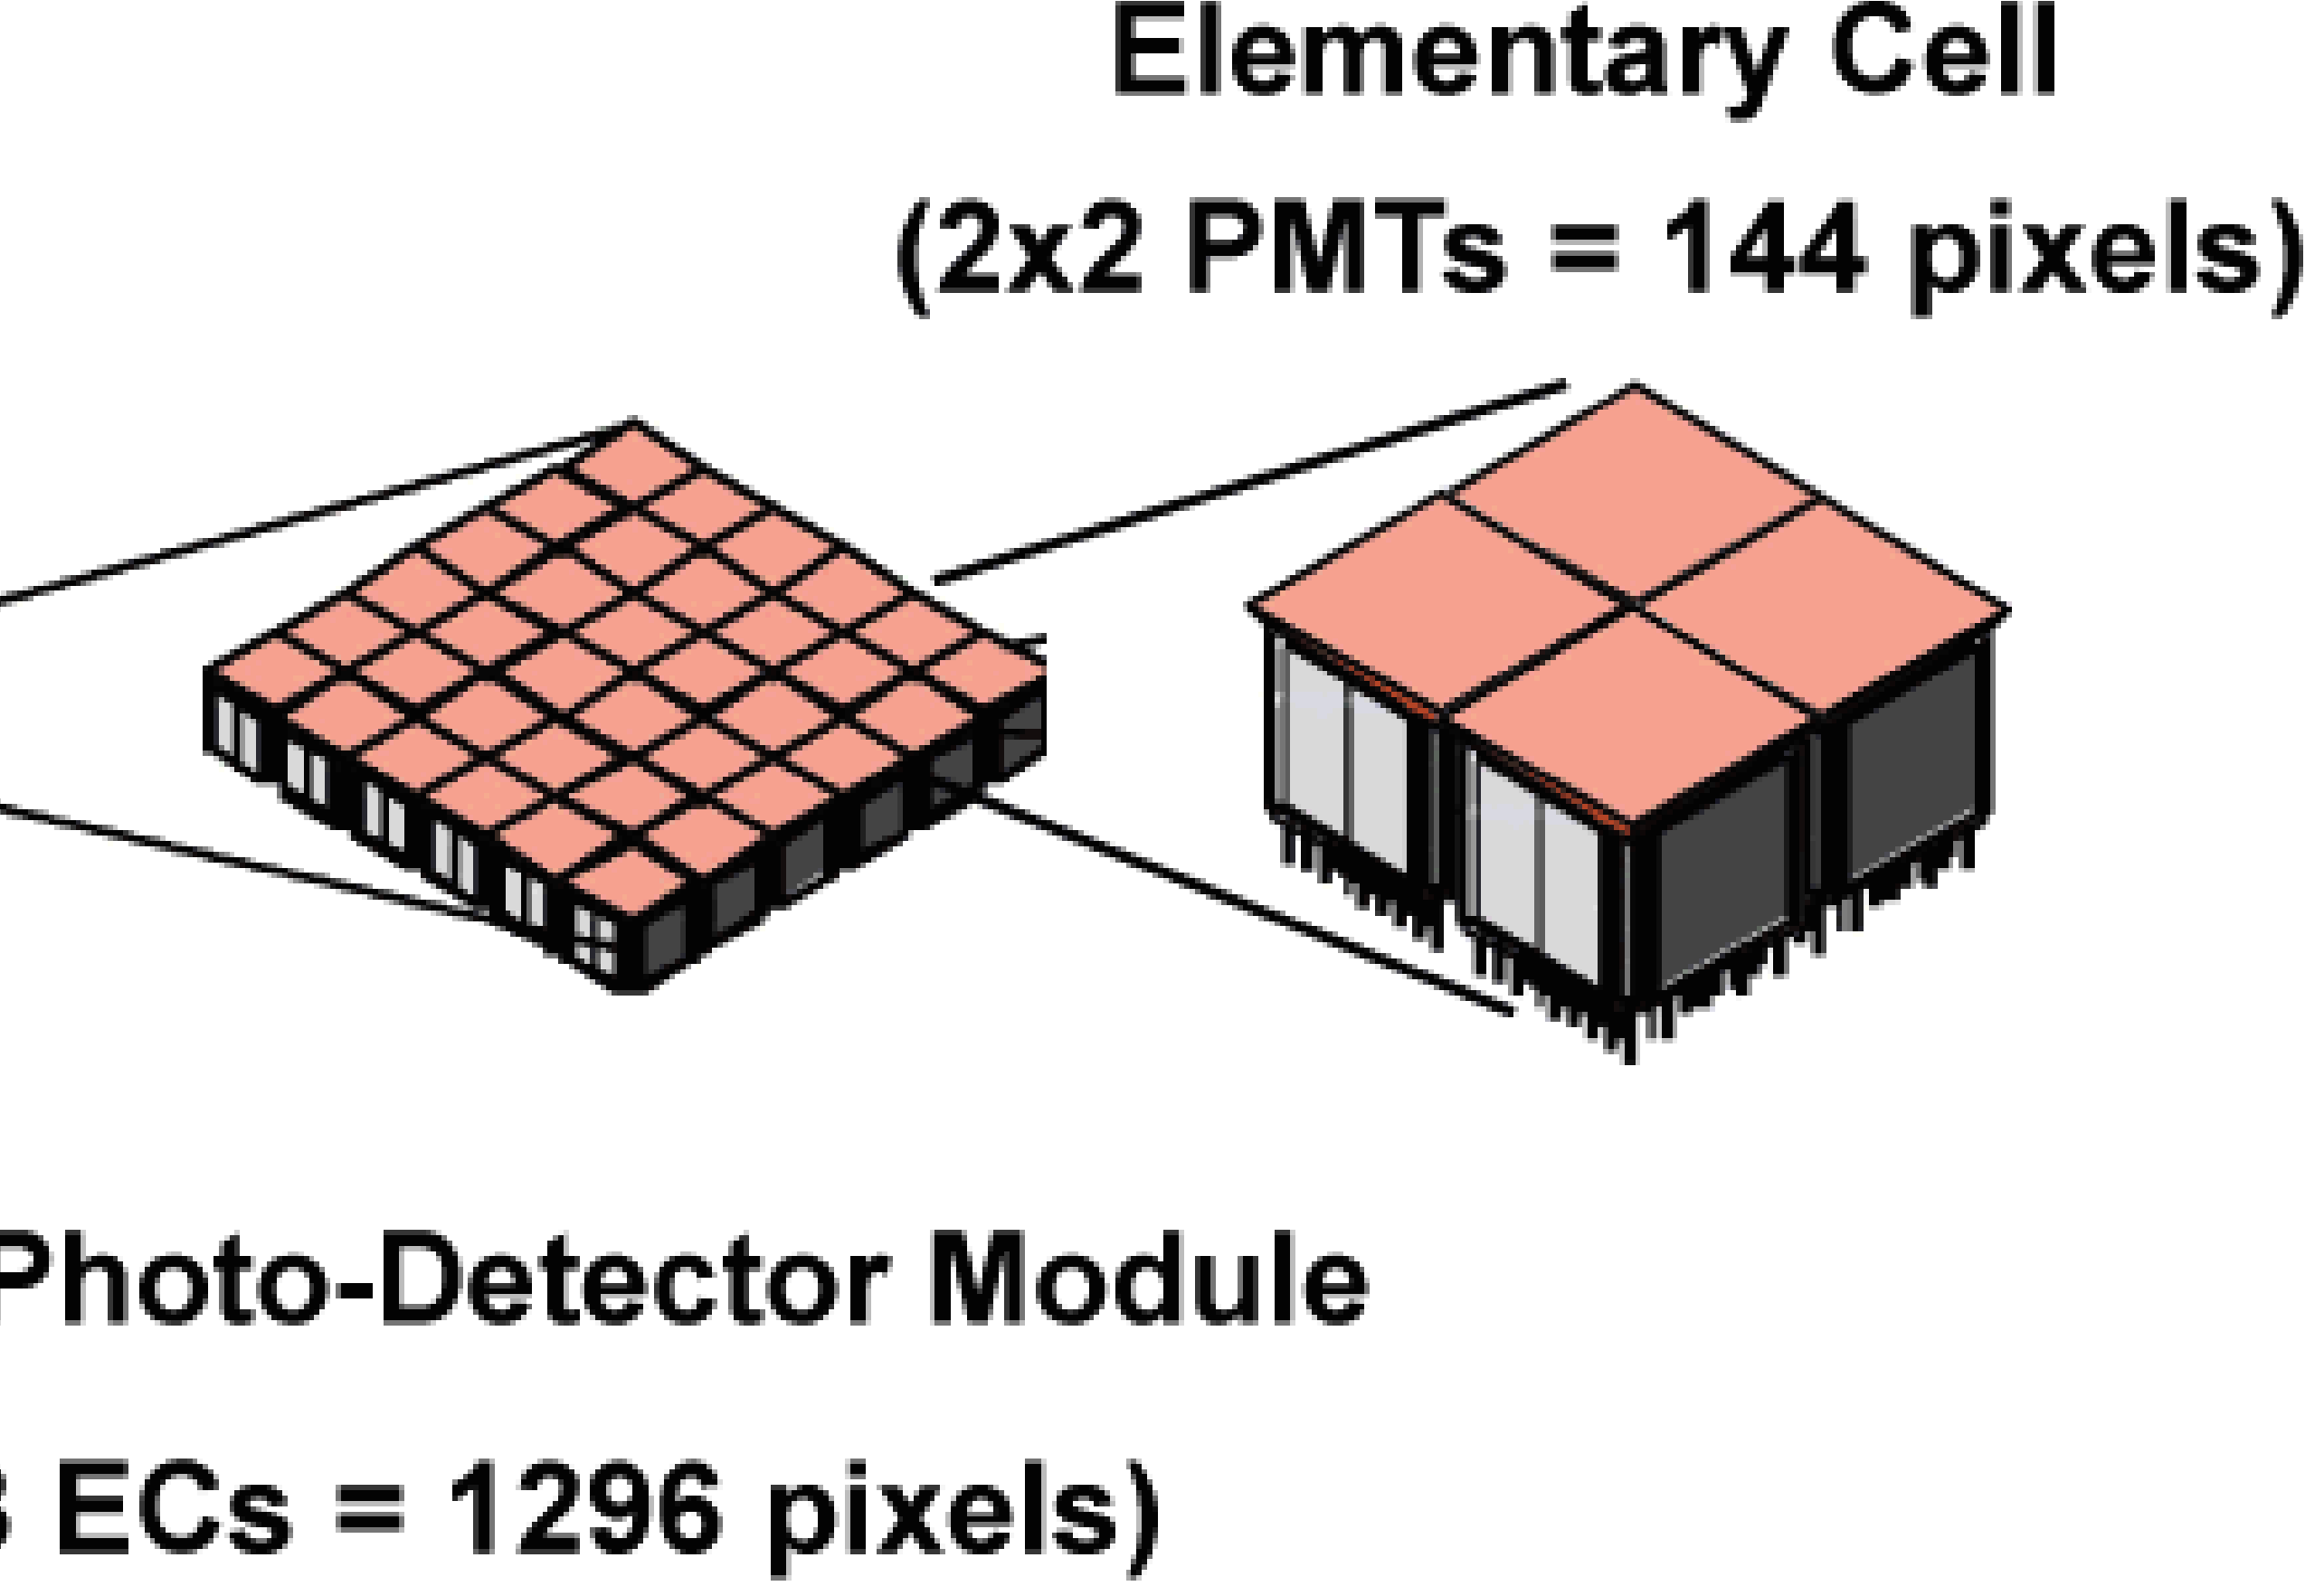
Focal surface
PDM
137 PDM of 9 EC, each EC has 4 PMT with 64 pixels each
4932 PMT and 0.3156 Megapixels

Slide 6
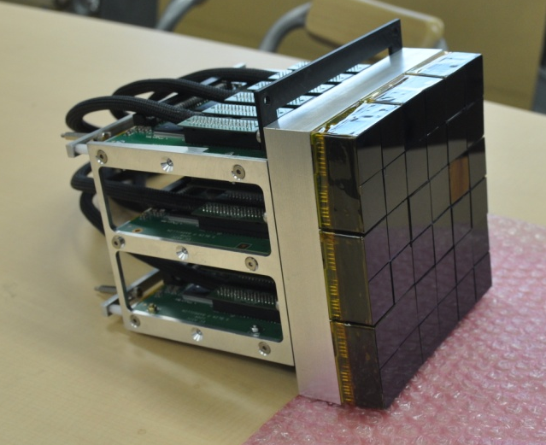
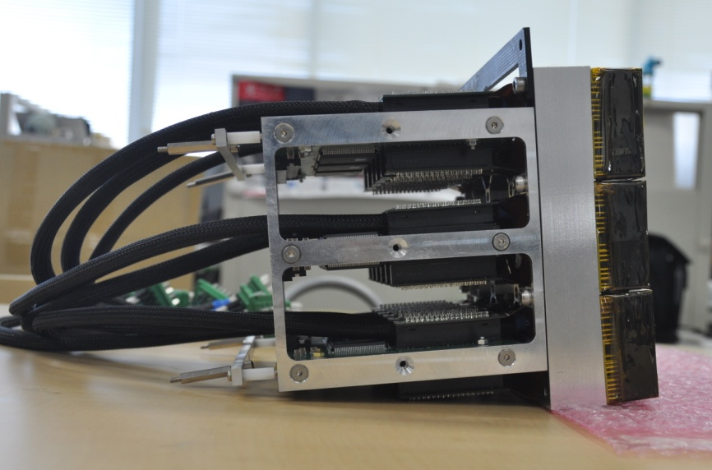
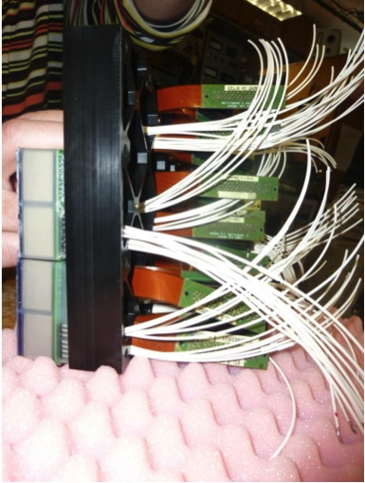
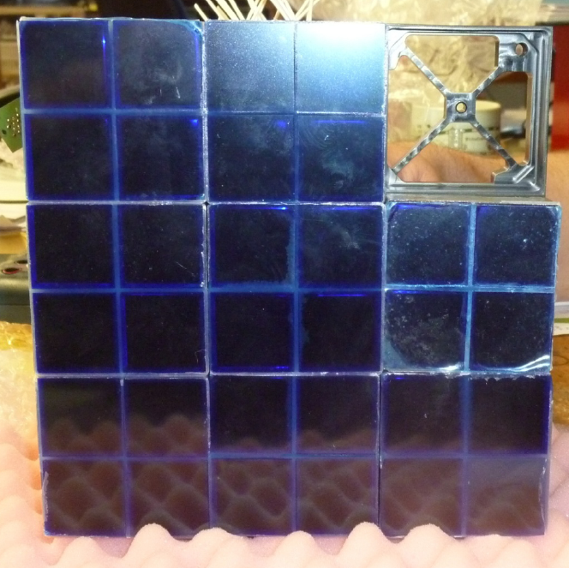
Photo-Detection Module (PDM)

Slide 7
Characteristics and advantages
Huge field of view (60° aperture)
Ultra-sensitive UV camera (single photon counting)
Ultra-fast camera (2.5 µs → 400 000 images/second)
Large dynamic range (automatic gain switches)
Over 300 000 pixels
Full-sky coverage, over several years
+ infrared camera + LIDAR

Slide 8
Many possible synergies
Atmospheric sciences
TLEs (sprites, jets, elves, halos…)
Cloud coverage
Links between cosmic rays and lightning
Airglow (nightglow) monitoring
Sciences of the ocean
Surface bioluminescence
Can a surface water temperature survey (3K accuracy) be useful?
LIDAR reflection → water level?
Meteorites sciences
Statistics, Trajectories, Recovery…
Space debris removal
identification, trajectory → laser shot
Others?
Plant fluorescence…

Slide 9
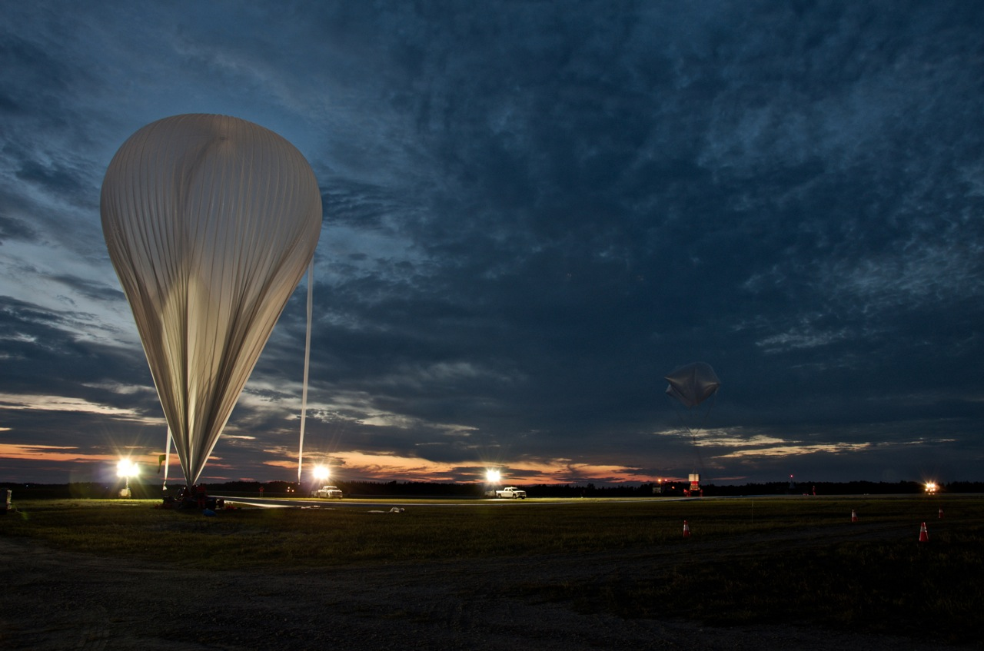
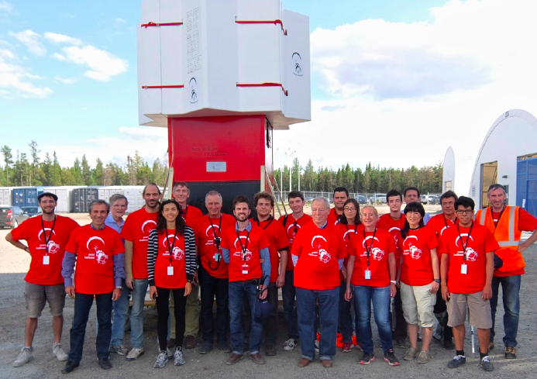
EUSO-Balloon
Pathfinder to JEM-EUSO (CNES mission)
Successful flight on August 24th, 2014 (Timmins, Ontario)

Slide 10
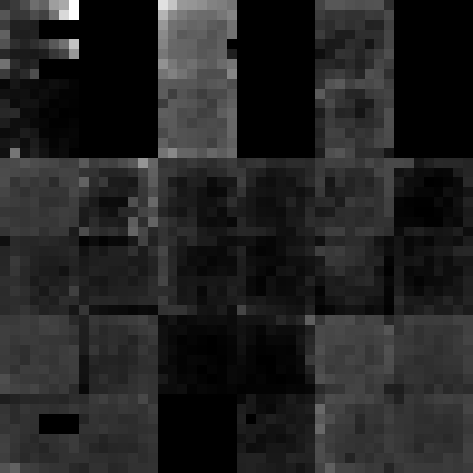

EUSO-Balloon
Pathfinder to JEM-EUSO (CNES mission)
Technology demonstration
Data on the UV background and its space/time variability
• additional to the airglow
• investigation of different types of ground / albedos
Observation of artificial transient events
laser shots + LED + Xenon flashers (US/NASA)

Slide 11
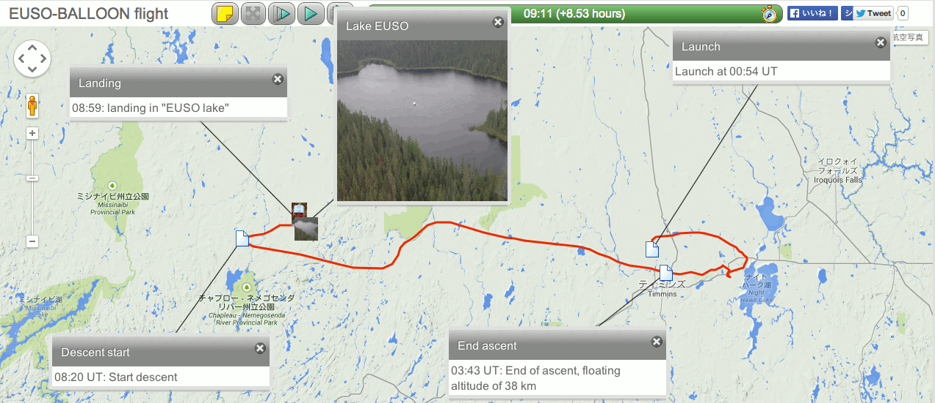
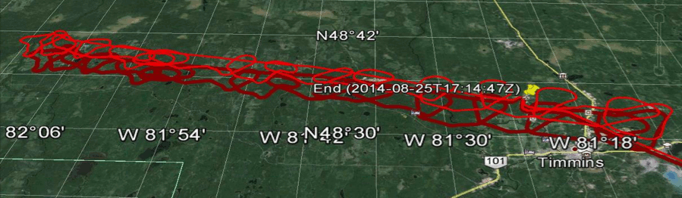
EUSO-Balloon + helicopter

Slide 12
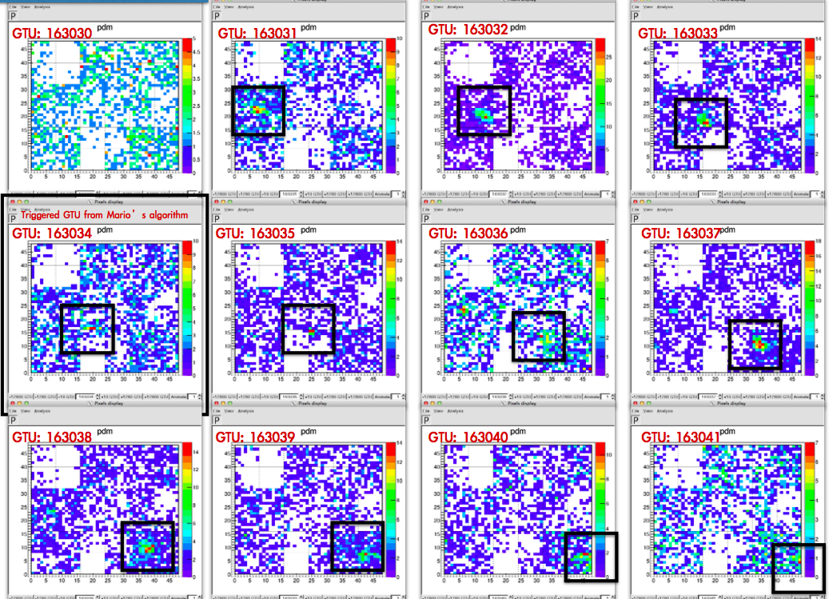
EUSO-Balloon
The data are being analyzed right now!

Slide 13
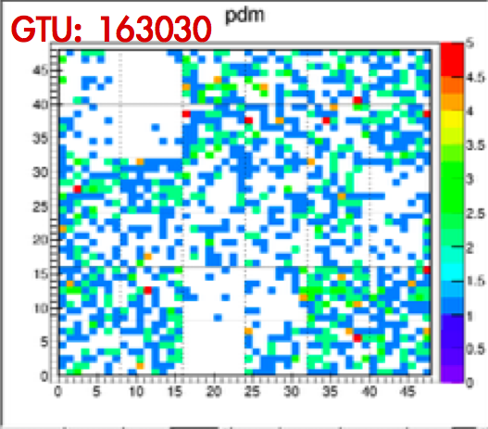
EUSO-Balloon

Slide 14
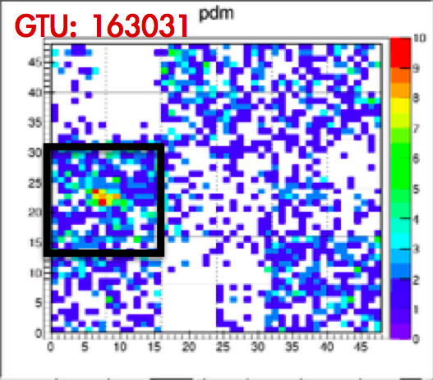
EUSO-Balloon

Slide 15
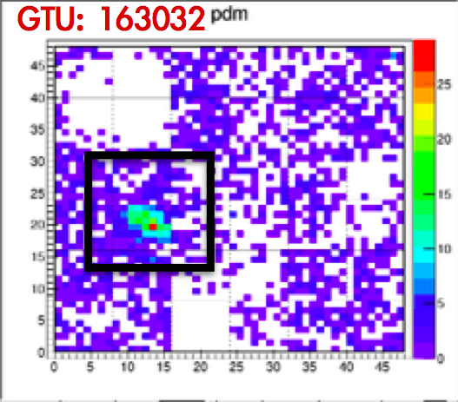
EUSO-Balloon

Slide 16
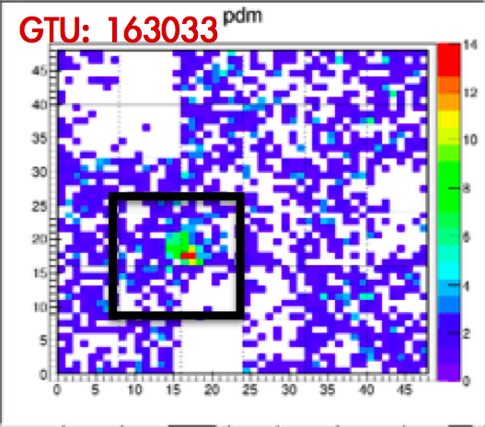
EUSO-Balloon

Slide 17
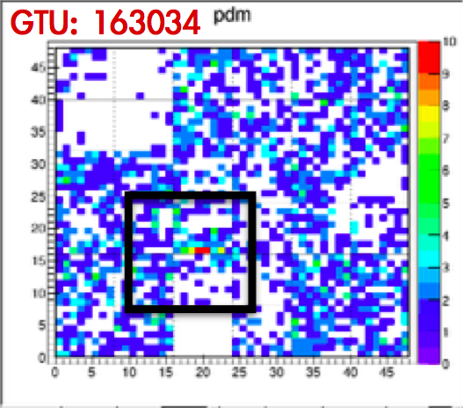
EUSO-Balloon

Slide 18
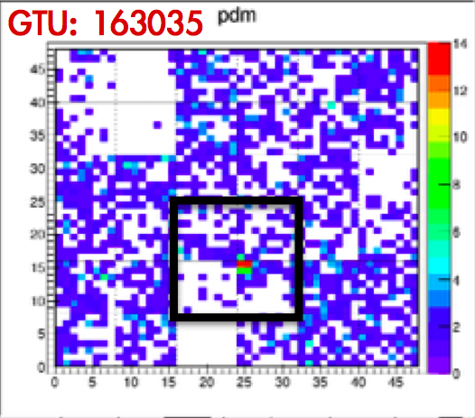
EUSO-Balloon

Slide 19
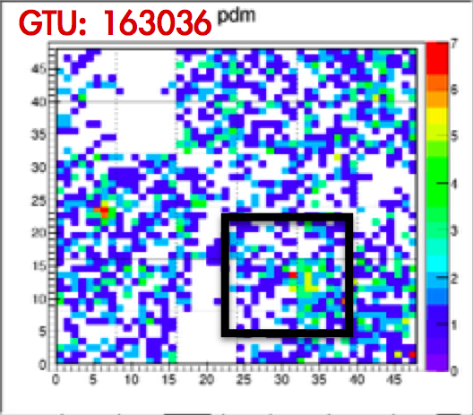
EUSO-Balloon

Slide 20
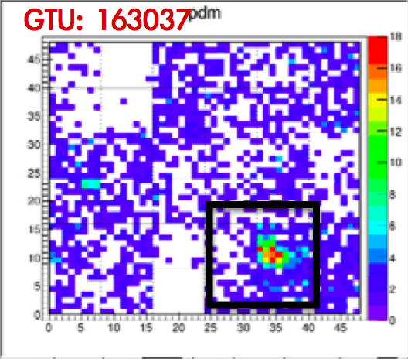
EUSO-Balloon

Slide 21
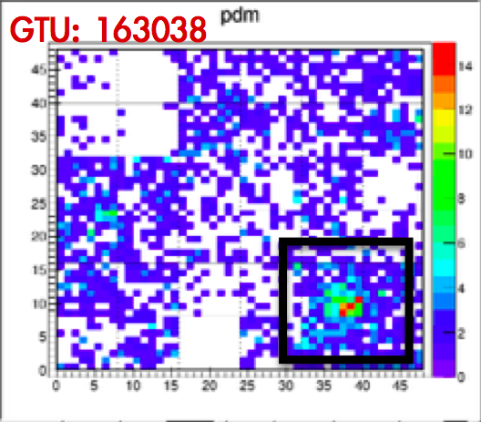
EUSO-Balloon

Slide 22
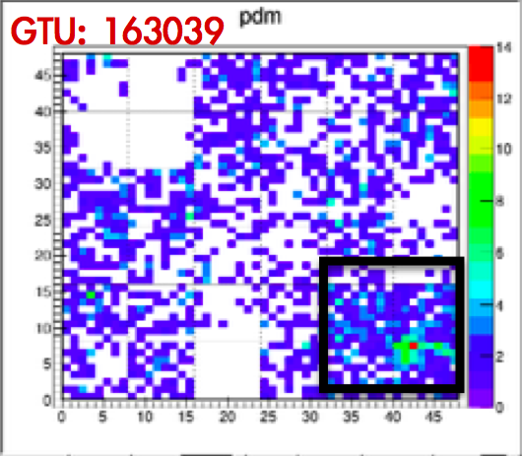
EUSO-Balloon

Slide 23
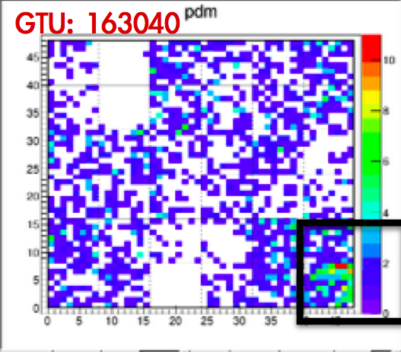
EUSO-Balloon

Slide 24
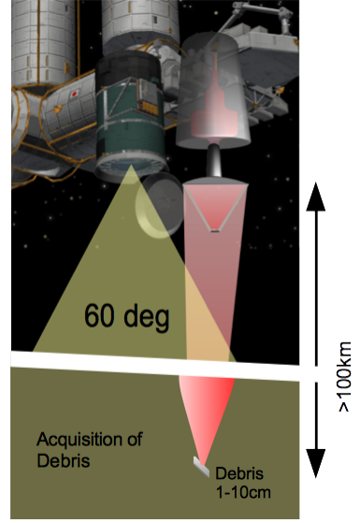
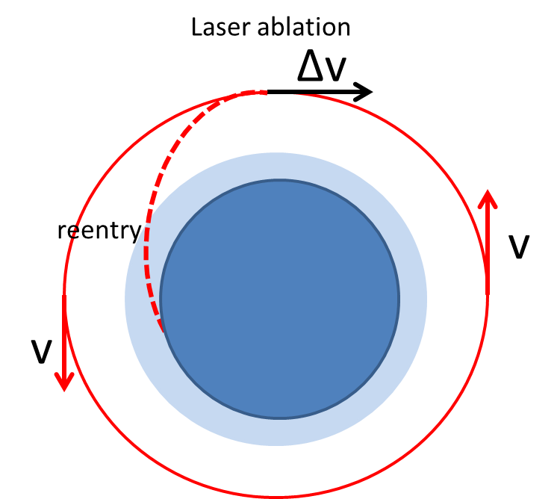
Space debris removal
Strategy
JEM-EUSO can detect and determine the trajectory of debris in the critical 1 cm – 10 cm range!

Slide 25
Next steps
Long duration balloon flight
Expected strong support from both CNES and NASA
Key milestone: detect the first UHECR showers from above (with the fluorescence technique, well established on ground)
Mini-EUSO
Approved mission
ASI (Italian Space Agency) and ROSCOSMOS)
JEM-EUSO demonstrator onboard the ISS (inside, not outside)
Will include test SiPMT detectors
Will observe airglow from space
Will observe TLEs and meteors
Can demonstrate space debris removal strategy
(to be operated in the ISS in 2017)

Slide 26
Thank you!

Slide 27
Back-up slides
Transient luminous events
Meteor(ite)s
EUSO-Balloon
Space debris removal strategy

Slide 28
Back up - I – Transient luminous events (TLEs)

Slide 29
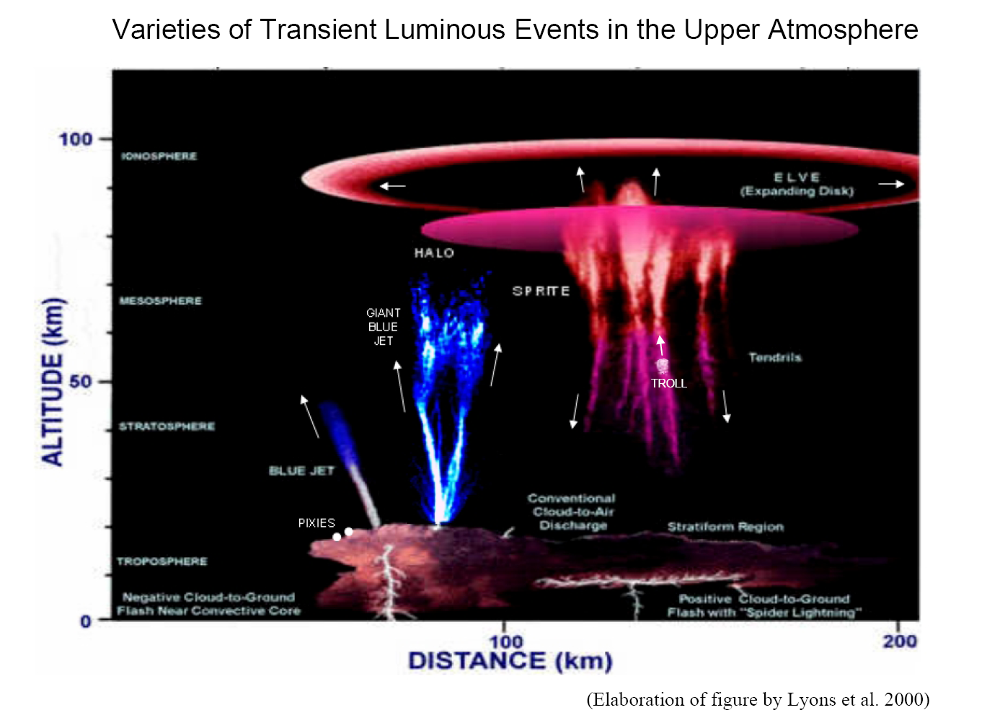
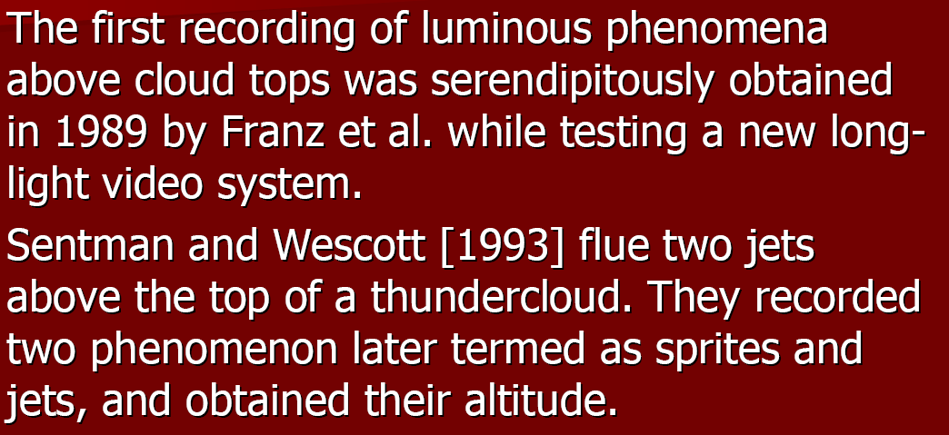
TLEs (sprites, jets, elves, halos …) are the effects of intensive interaction between different regions in the space around Earth

Slide 30
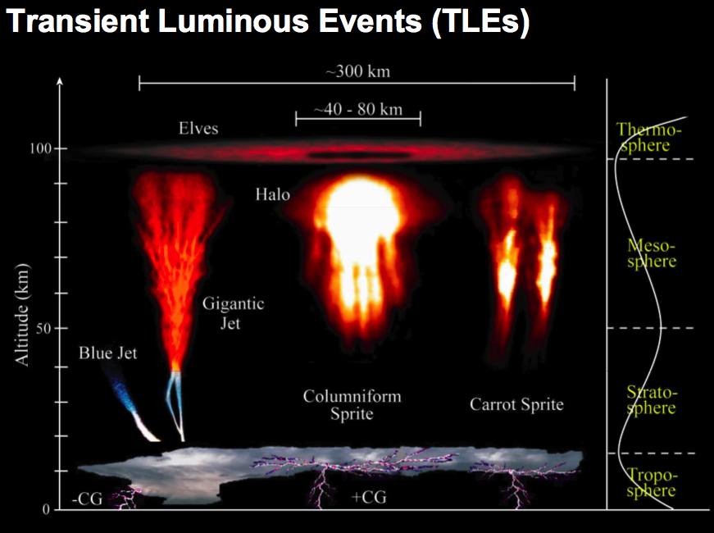
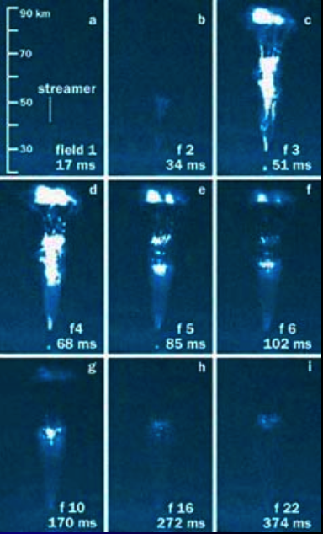
Ionosphere phenomena

Slide 31
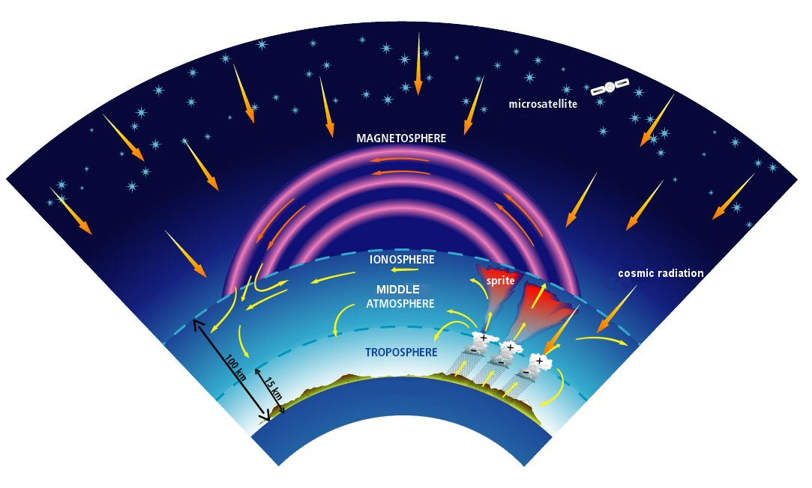
TLE are associated with the electromagnetic connections and interactions between atmosphere, ionosphere and magnetosphere and with strong thunderstorm activity

Slide 32
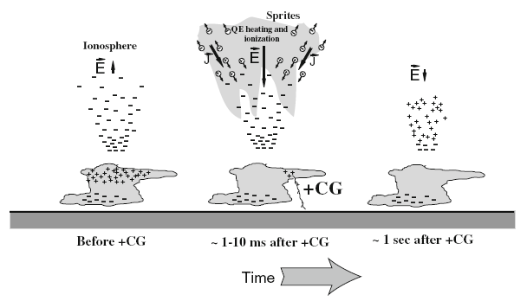

Slide 33
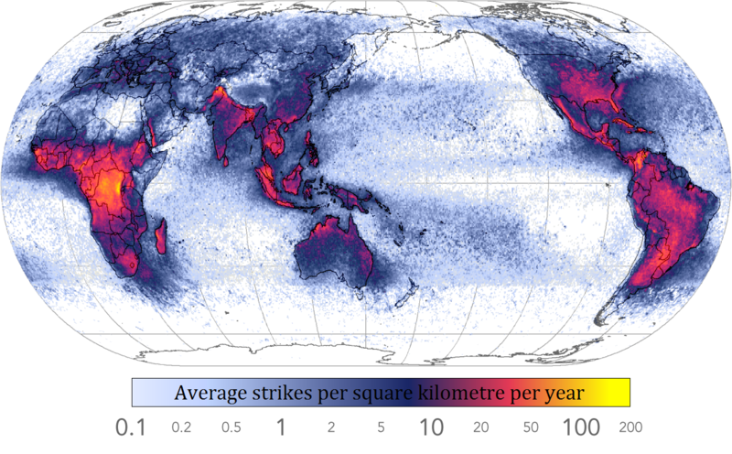

Slide 34
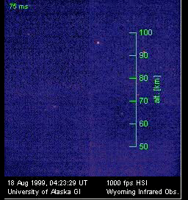

Slide 35
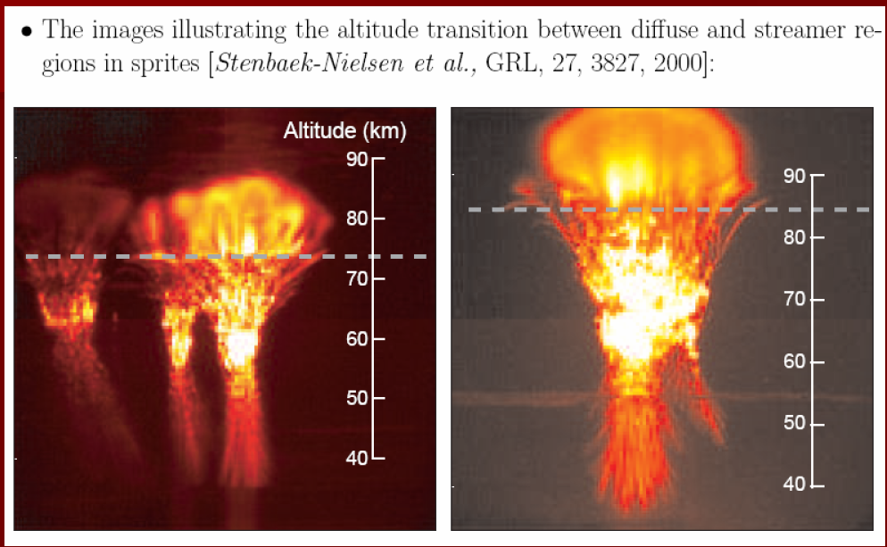

Slide 36
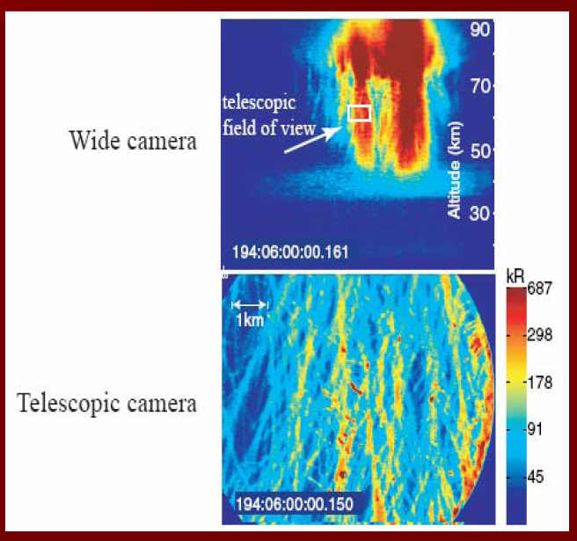

Subtle structure of the sprite

Slide 37
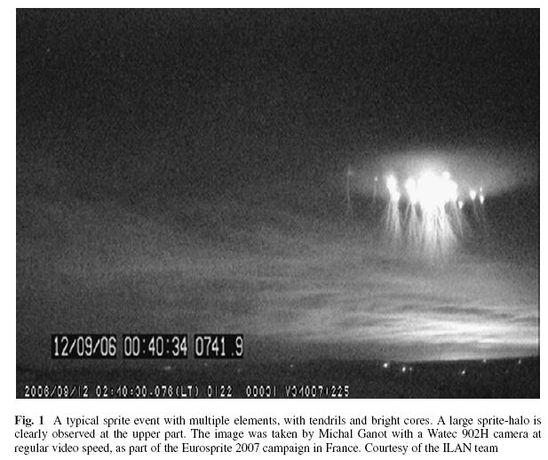

Slide 39
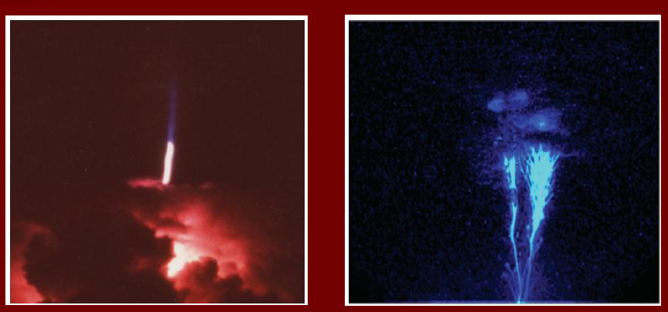
Blue and giant blue jets

Slide 40
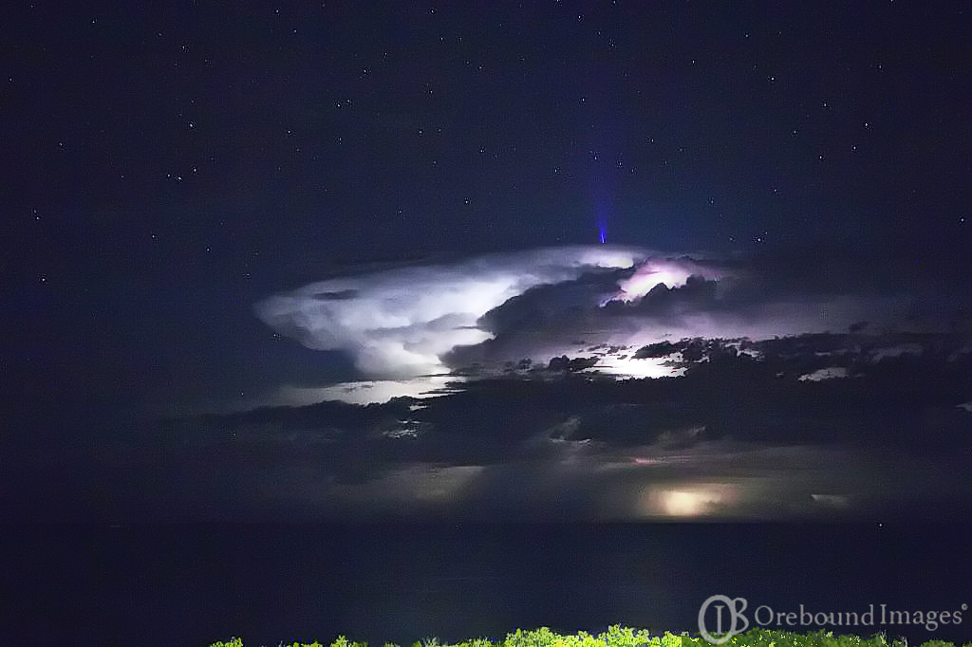

Slide 41
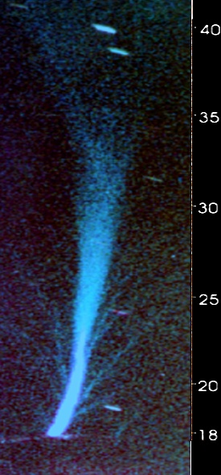
Blue Jet structure
[Wescott,et al., JGR, 2001]
At the base of the jet the diameter ~400m.
The diameter does not vary till ~22 km.
At 27 km it broadens to ~2 km, and is ~3 km at 35 km.
Eight smaller streamers with 50-100 m diameter detected.
Lifetime of the event ~0.1 s.
Was not associated with any particular CG lightning.
The total optical brightness reached 6.7 MR (0.5 MJ of optical energy).
3km
2km
50-100m
0.4km

Slide 42

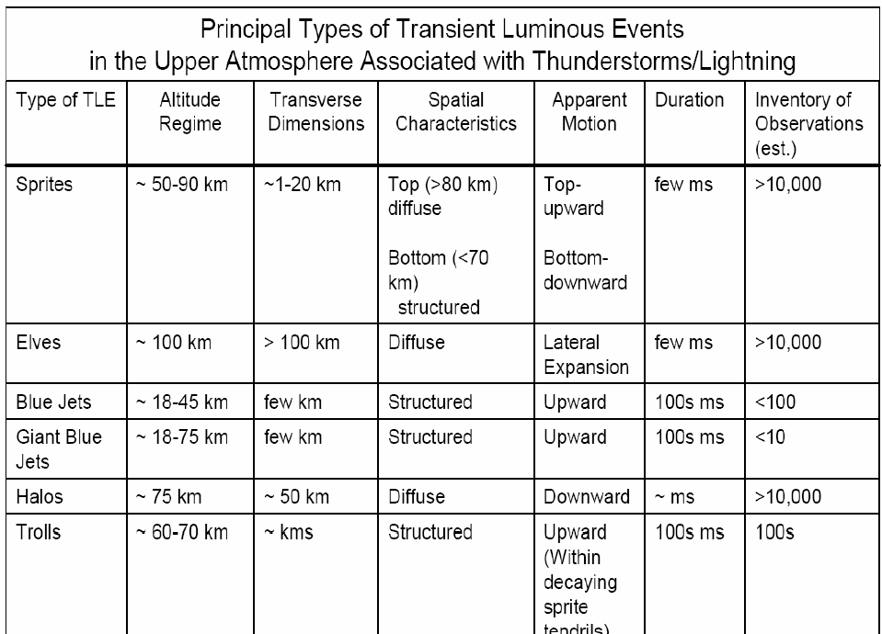

Slide 43
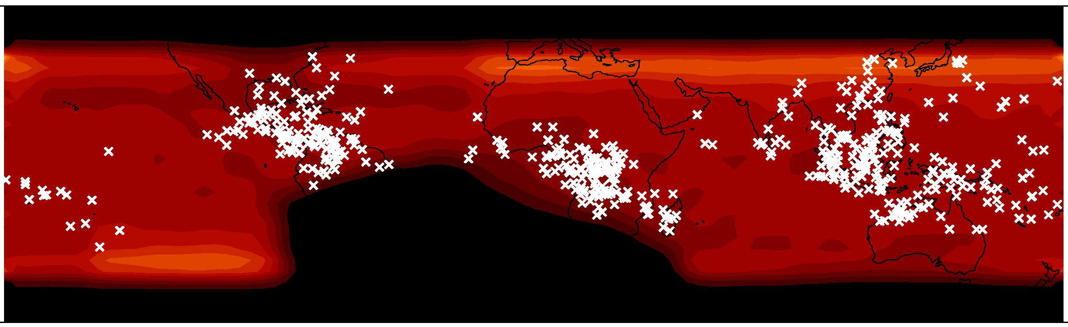
RHESSI : (Terrestrial Gamma Flashes TGFs)
498 events in 37 months
Smith et al., 2005

Slide 44


Slide 45

Interaction with radiation belt

Slide 46

2009 TOHOKU UNIVERSITY

Slide 47

Tool for the Analysis of RAdiations
from lightNIngs and Sprites =TARANIS

Slide 48
THE ATMOSPHERIC-SPACE INTERACTION MONITOR

Slide 50

FILAMENTATION OF THE SPACE PLASMA

Slide 51


Slide 52


Slide 53
Field-Aligned Currents and Filaments in Space Plasmas
Filamentary strucures are found in the following space plasmas, all of which are observed or are likely to be associated with electric currents:
1.In the aurora filaments parallel to the magnetic field are often observed. These can have dimensions down to 100m.
2. Inverted V events (105 -106 A) and in situ measurements of the electric currents in the magnetosphere demonstrate the existence of the filamentary structures
3. In the ionosphere of Venus „flux ropes” or „magnetic ropes”, whose filamentary diameter are typically 20km, are observed.

Slide 54
4.In the Sun, prominences (1011A), spicules, coronal streamers, polar plumes etc. Show filamentary structure whose dimensions are in order 107-108m.
5.The cometary tails often have a pronounced filamentary structure.
6.In the interstelar medium and in the interstelar clouds there is a abundance of the filamentary structures.
7.The center of the Galaxy, where twisting plasma filaments, apparently held together by magnetic field possesing both azimutal and poloidal components, extend for nearly 60pc (1018 m.)

Slide 55
Physical Mechanisms of Filamentation
There are two fundamental physical mechanisms trying to explain a creation of the filamentary structure in the space plasmas. Both are associated with currents and ambient magnetic field.
1.Pinch instability of the field aligned electric current (Galperin et al. 1986)
2.Filament instability of the dispersive Alfven waves (Shukla and Stenflo 1989, Lavader et al. 2001)

Slide 56


Slide 57
SUMMARY
The characteristics of the TLE’s have been described by different groups working with detectors on the orbit and on ground detecting systems.
JEM EUSO is unique in that its time and spatial resolution is very high and it will allow to see evolution in time of the subtle structure (filamentation) of TLE’s.
There will be two more experiments dedicated to measuring the TLEs on the orbit soon ASIM and Taranis.
The set of data produced by all these experiments may create an exceptional chance to further investigate the physical nature of the TLEs.

Slide 58
Back up - II - Observation of meteor(ite)s with JEM-EUSO

Slide 59


Slide 60


Slide 61


Slide 62


Slide 63


Slide 64


Slide 65


Slide 66


Slide 67


Slide 68
Back up – III – EUSO-Balloon

Slide 69
EUSO-BALLOON
A balloon-borne fluorescence telescope, pathfinder of JEM-EUSO
1 PDM with electronics and mechanics as close as possible to JEM-EUSO
DAQ & BG study
Detection EAS > ~10¹⁸eV from an altitude of 40km (expected 0.2-0.3 events with E>2×10¹⁸ eV during 10 hours night-flight)
CNES project with IRAP, APC & LAL + support of the whole JEM-EUSO collaboration
 | JEM-EUSO | EUSO-BALLOON
Height [km] | 420 | 40
Diameter [m] | 2.5 | 1
FoV/pixel [deg] | 0.08 | 0.25
Pixel@ground [km] | 0.058 | 0.175
FoV/PDM [deg] | 3.8 | 12(8)
PDM@ground [km] | 28.2 | 8.4
Signal Ratio | 1 | 17.6
BG Ratio | 1 | 0.9-1.8
S/√N | 1 | 20-10
Eth [eV] | 3×10¹⁹ | 1.5-3×10¹⁸
# of PDM | 137 | 1
1st launch was successfully carried out on August 24-25th 2014, Timmins (Canada)

Slide 70


EUSO-BALLOON ‘‘in flight’’ calibration
Balloon
Testing EUSO-Balloon
Fly one aircraft equipped with
two types of calibrated pulsed UV light sources.
Point Test: Fly airplane in field of view and fire flash lamp. Light travels directly from lamp to detector
Track Test: Fly airplane outside field of view and shoot a UV pulsed laser across field of view. Light scatters out of the beam to the detector.
(5 mJ Laser ~100 EeV Cosmic Ray)
Fly aircraft at altitudes between 1-5 km.
~40 km
EUSO
detector
Field of View
Point
Test
Helicopter equiped with
laser and Xenon flasher
Calibrated
Flash lamp
4 km

Slide 71

EUSO-BALLOON Instrument
Instrument
• Mechanical structure (gondola)
• Optics: 2 flat Fresnel lenses (L1&L3)
• 1 Photodetector Module (PDM)
• Data acquisition system (DAQ)
• Monitoring controlled by House Keeping system (HK)
• A set of power supplies (LVPS) powered by onboard batteries (Power Pack)
• An IR camera for atmospheric monitoring

Slide 72








EUSO-BALLOON
Data Acquisition (DAQ) Chain
IR camera
Sensor (photodetector)
Front-end (FE) electronics
PMT
• Hmamatsu 64-ch MAPMT
• BG3 filter
EC-Unit
• 4 PMTs (256-ch)
readout cables
• HV board
• potting
EC-ASIC
• 6 x ASICs
• readout
• counter
PDM-Board
• Slow control
• Level 1 (L1, track) trigger
Data Processing (DP)
CPU
• Run control, config. FE electronics
• Console & GUI, remote access, etc.
• Data processing
• managing Mass Memory for data
storage
HK, LVPS
CCB
(Cluster Control Board)
• Receive data
from 9 PDMs

Slide 73



EUSO-Balloon

Slide 74

CNES Flight Chain
valve
Main elements
of an open
Stratospheric
balloon
20 m
~ 180 m
covering
Discharge sleeve
Remote separator
Parachute tension
Operational servitude pod (NSO)
100 m
~ 150 m
Radar refector
Beacon
Alticoder radar
responder
Scirnetific equipment
(EUSO-BALLOON main frame)
dampers
Scirnce telemetry pod

Slide 75


Laser track
Event profile

Slide 76
Other instruments onboard
Infrared Camera (IR Camera)
NIST photodiode
Gerger counter
GPS
Attitude sensor
GoPro camera
Independent of data acquisition systems
Offline synchronization (UTC time stamps)

Slide 77




Complementary and/or anecdotal data
  Light intensity (NIST)
  Cosmic ray intensity (Geiger)
  Temperature eveolution
  Infrared data

Slide 78
Back up – IV – Space debris removal strategy

Slide 79

Quinn et al. (2014): Acta Astronautica 105, 192-200

Slide 80

Quinn et al. (2014): Acta Astronautica 105, 192-200

Slide 81

Quinn et al. (2014): Acta Astronautica 105, 192-200

