Slide 1
JEM-EUSO and Co.
Observation des rayons cosmiques d’ultra-haute énergie depuis l’espace
Quelles synergies avec les sciences de la Terre et de l’atmosphère ?
Etienne Parizot
(APC – Université Paris Diderot - France)

Slide 2
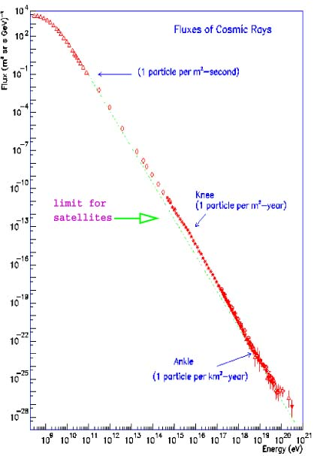
Le spectre d’énergie des rayons cosmiques
Flux
~ 1 particule par m² par seconde
~ 1 particule par m² par an
10²¹ eV
~ 1 particule par m² par milliard d’années !
100 MeV
Énergie

Slide 3
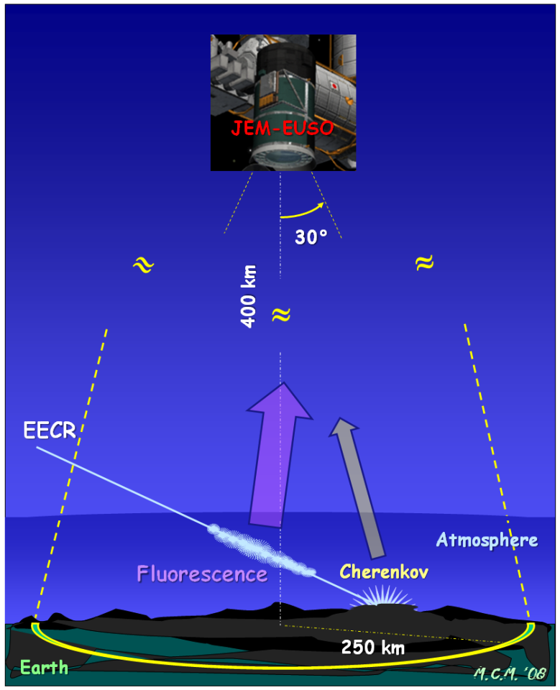
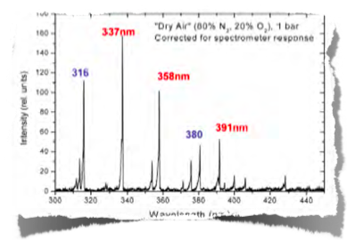
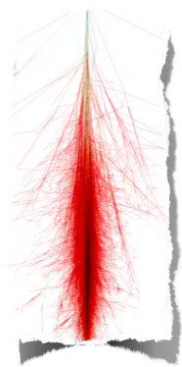
Le principe de JEM-EUSO
“Gerbe atmosphérique”

Slide 4
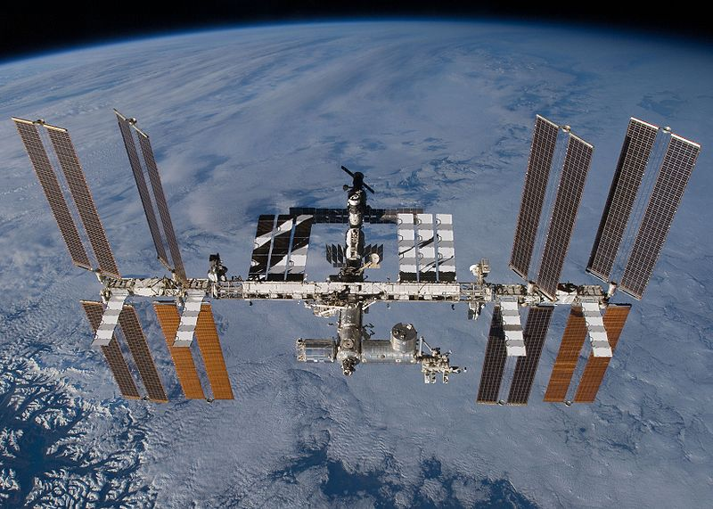
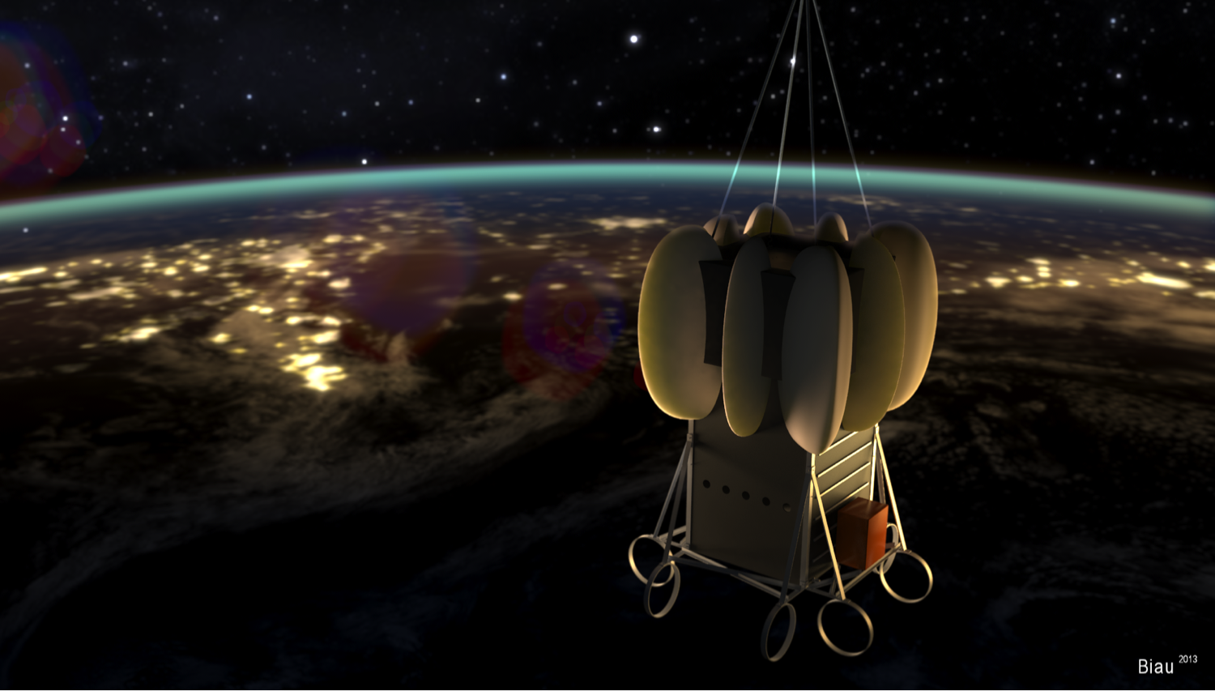
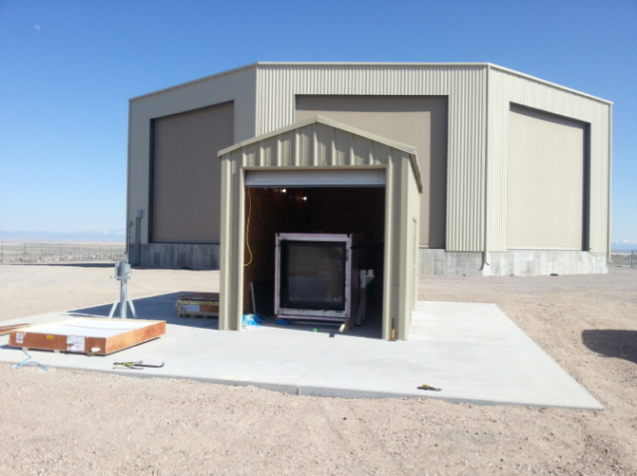
JEM-EUSO et ses pathfinders…
EUSO-Ballon
Mini-EUSO
JEM-EUSO
(+ EUSO-Phil)
EUSO-TA (telescope array)

Slide 5
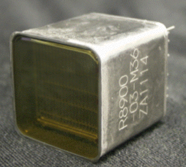
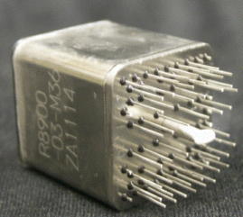
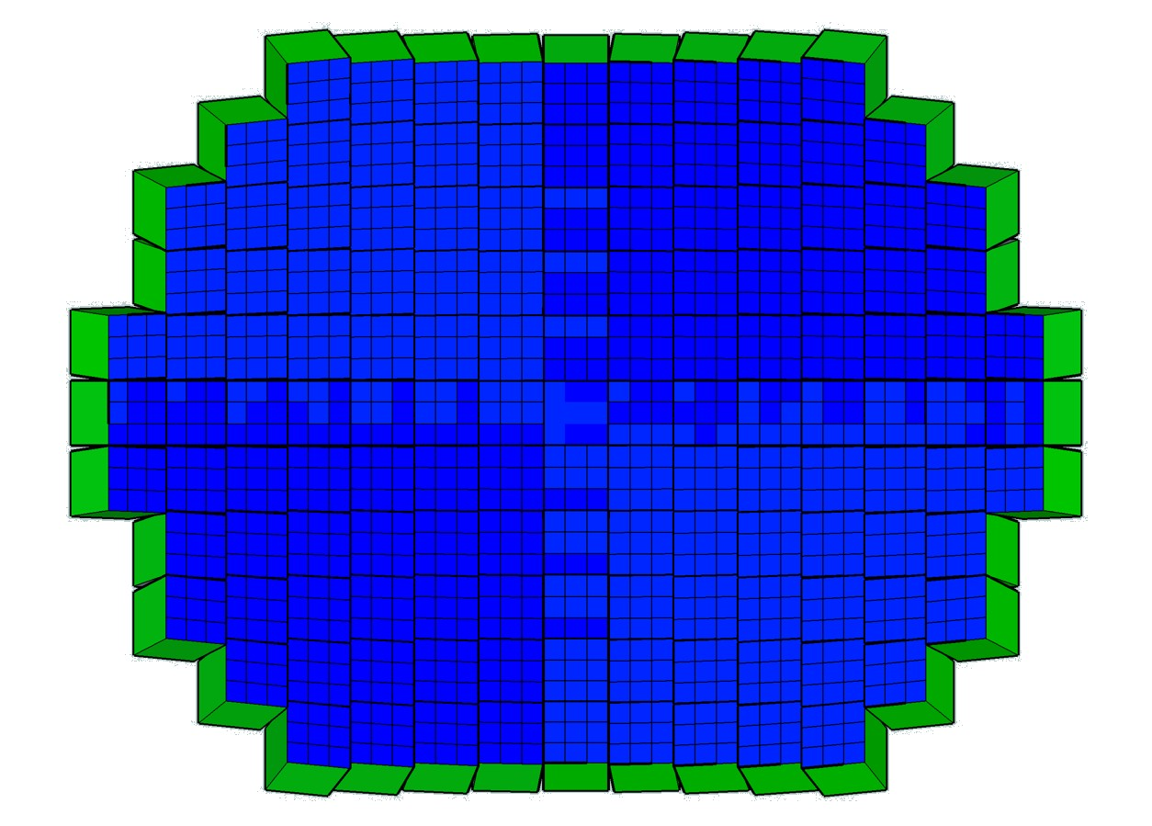
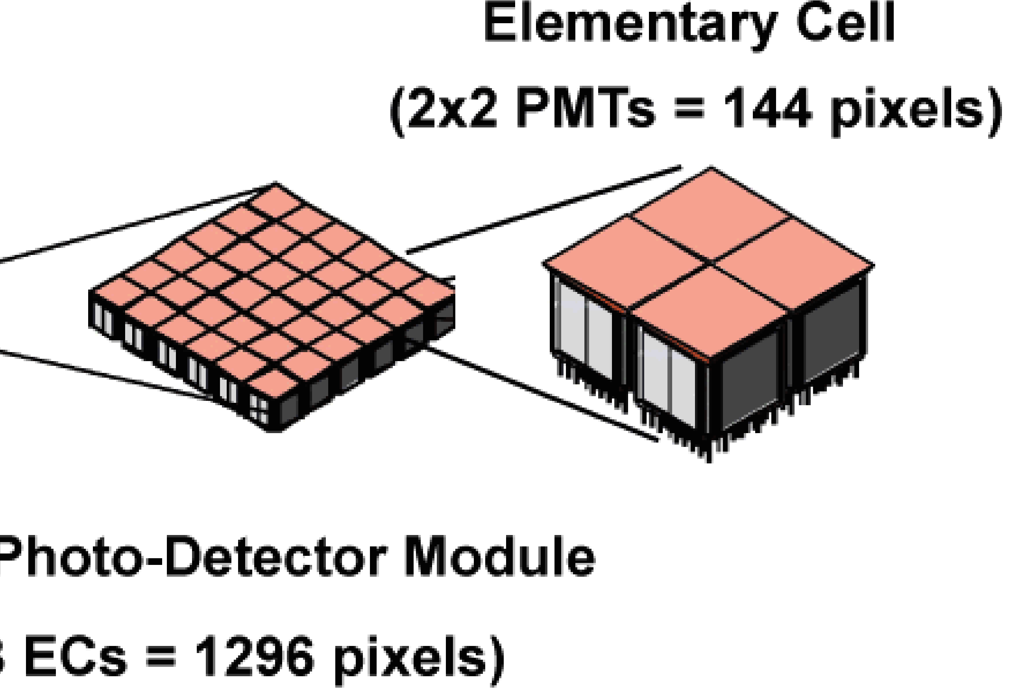
Focal surface
PDM
137 PDM of 9 EC, each EC has 4 PMT with 64 pixels each
4932 PMT and 0.3156 Mpixels

Slide 6
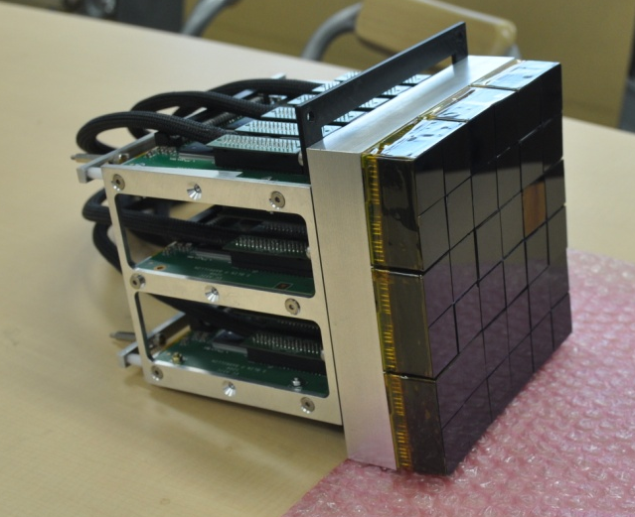
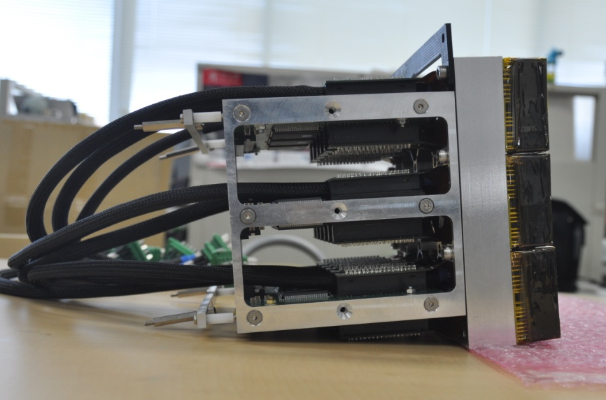
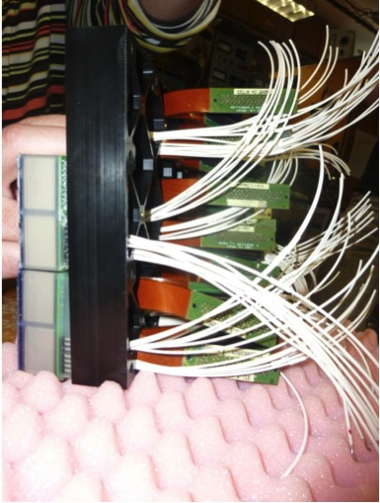
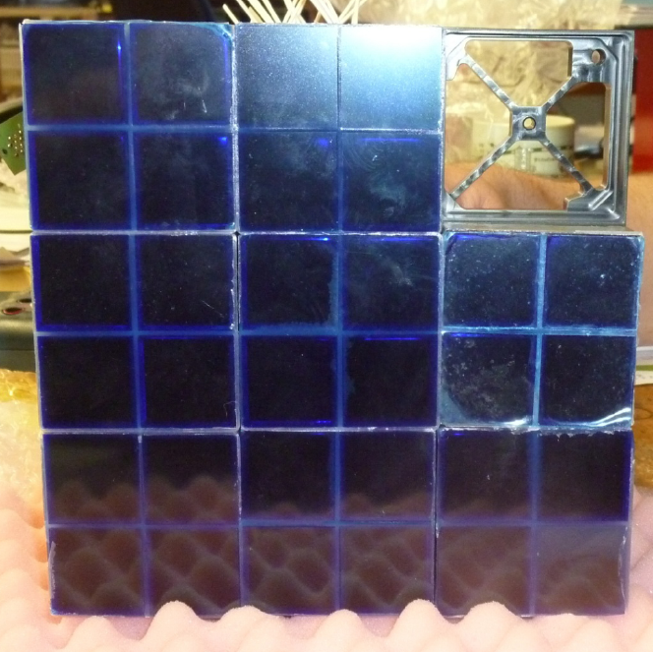
Photo-Detection Module (PDM)

Slide 7
Caractéristiques et atouts
Énorme champ de vue (60° d’ouverture)
Caméra ultra-sensible dans l’UV (photon unique)
Caméra ultra-rapide (2.5 µs)
300 000 pixels
Couverture globale de la Terre, sur plusieurs années
+ Caméra infrarouge !
+ LIDAR

Slide 8
Synergies possibles
Sciences de l’atmosphère
TLEs (sprites, jets, elves, halos…)
Couverture nuageuse
Autres ?
Sciences de l’océan ?
Bioluminescence de surface
Autres ?
Sciences des météorites
Statistique, Trajectoires, etc.
Autres ?

Slide 9
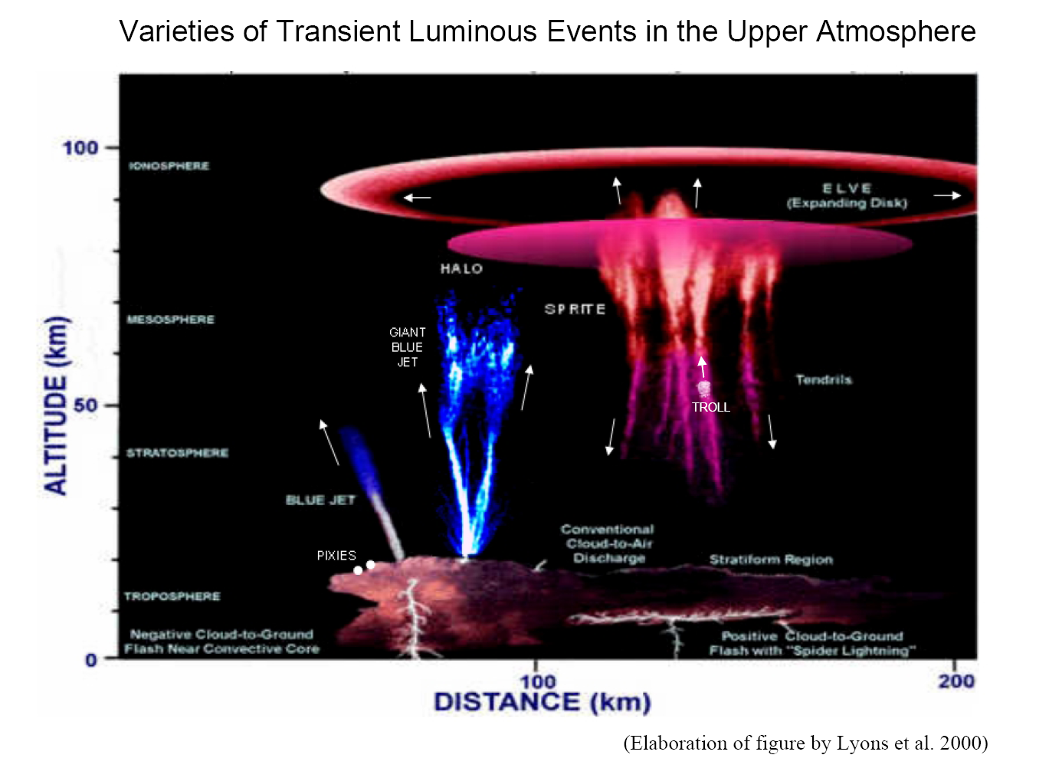
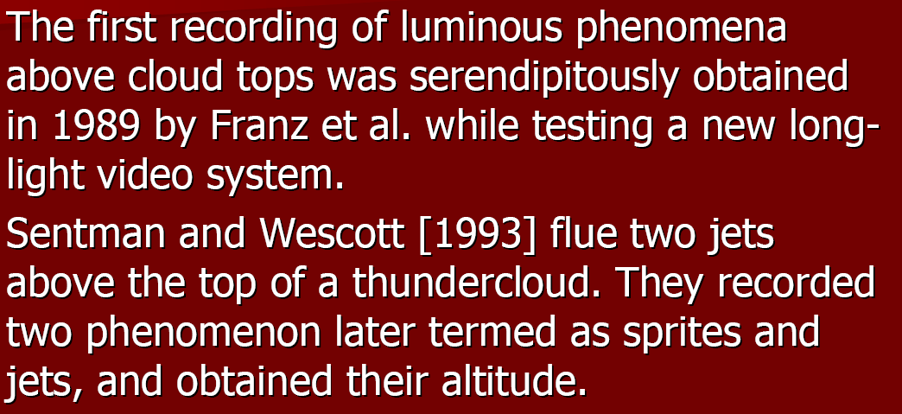
TLEs (sprites, jets, elves, halos …) are the effects of intensive interaction between different regions in the space around Earth

Slide 10
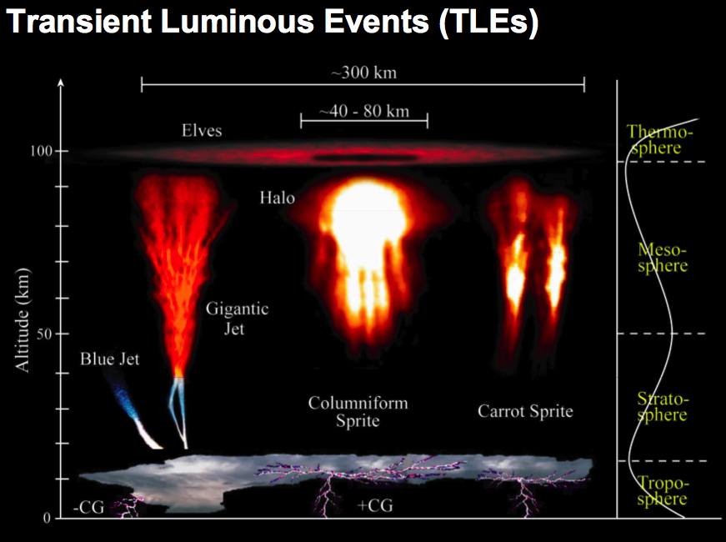
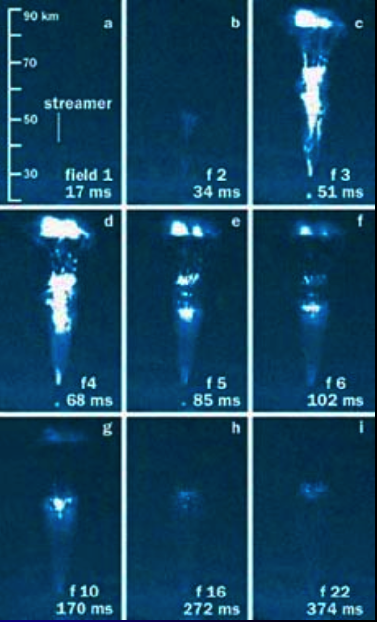
Phénomènes ionosphériques

Slide 11
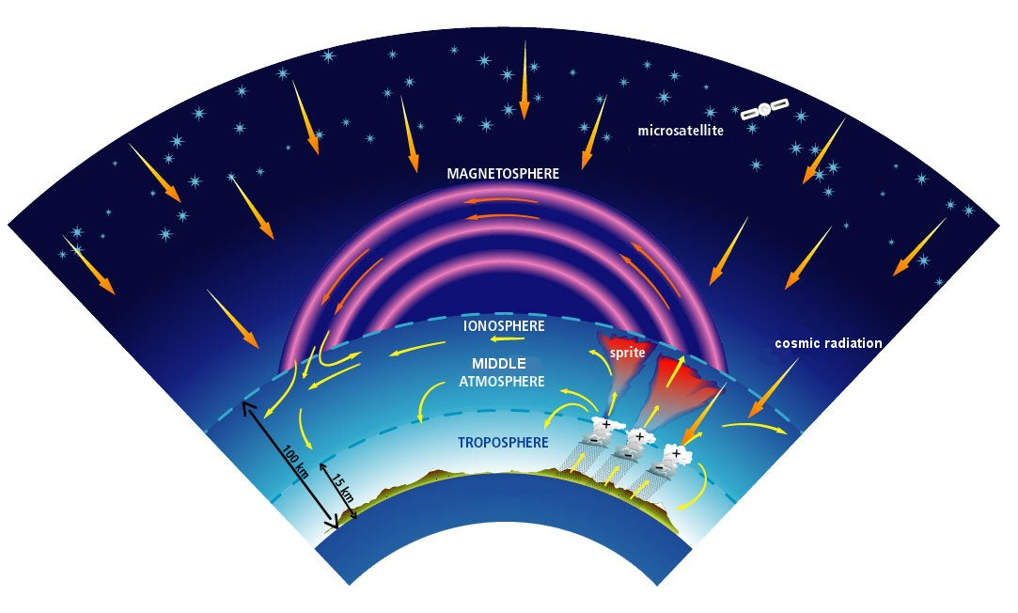
TLE are associated with the electromagnetic connections and interactions between atmosphere, ionosphere and magnetosphere and with strong thunderstorm activity

Slide 12
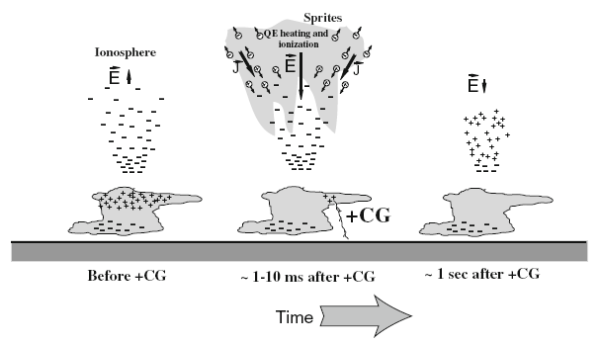

Slide 13
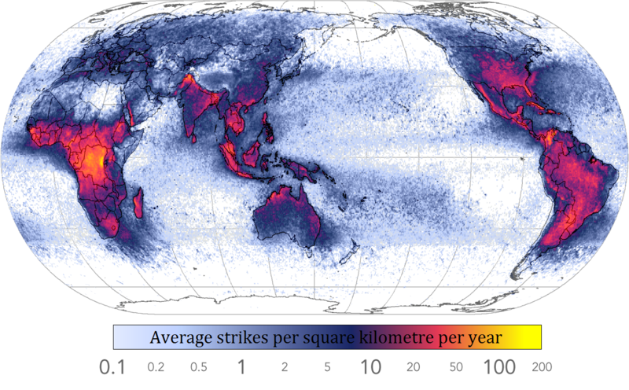

Slide 14
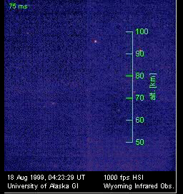

Slide 15
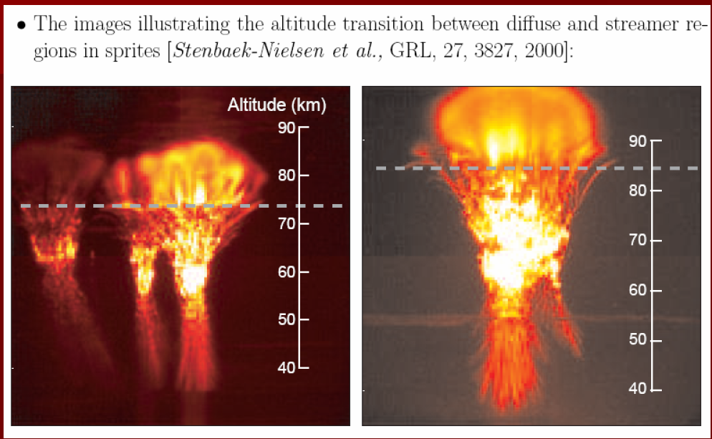

Slide 16
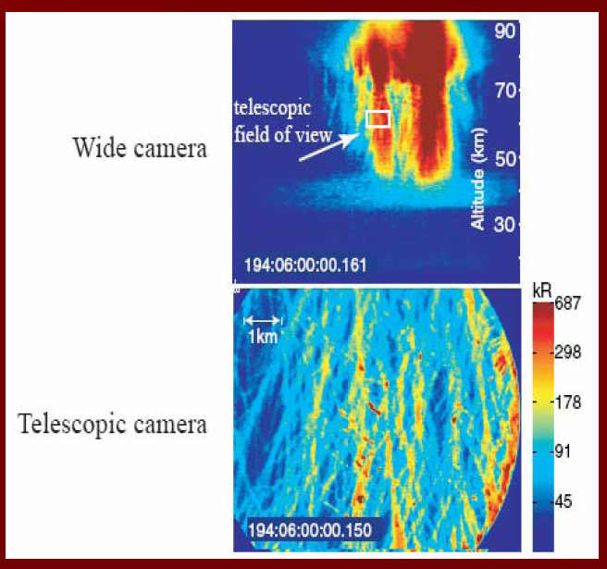

Subtle structure of the sprite

Slide 17
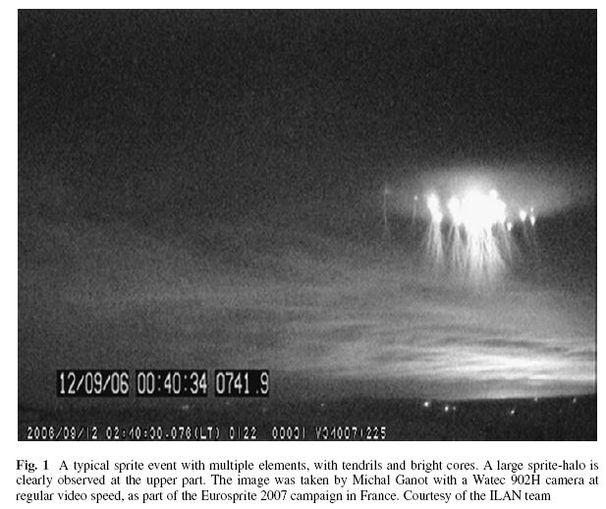

Slide 19
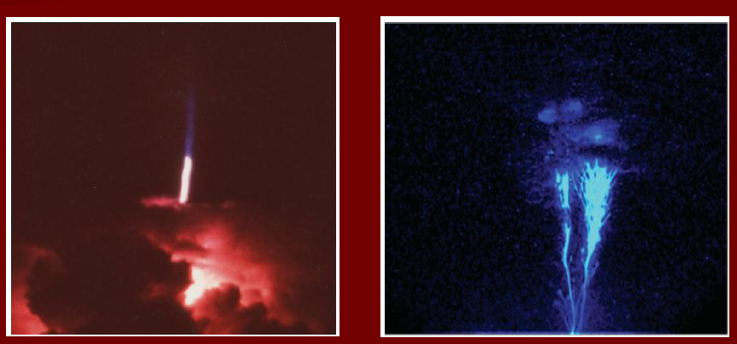
Blue and giant blue jets

Slide 20
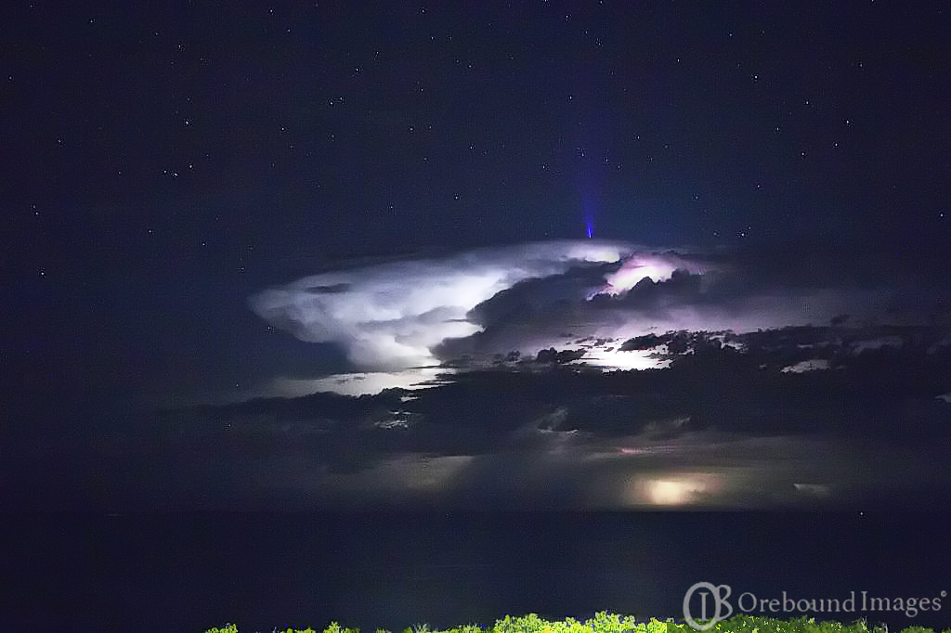

Slide 21
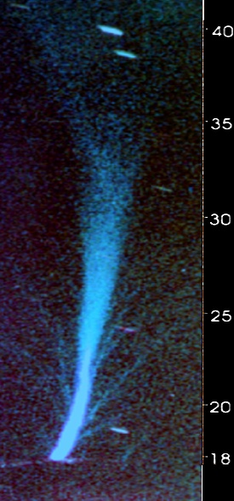
Blue Jet structure
[Wescott,et al., JGR, 2001]
At the base of the jet the diameter ~400m.
The diameter does not vary till ~22 km.
At 27 km it broadens to ~2 km, and is ~3 km at 35 km.
Eight smaller streamers with 50-100 m diameter detected.
Lifetime of the event ~0.1 s.
Was not associated with any particular CG lightning.
The total optical brightness reached 6.7 MR (0.5 MJ of optical energy).
3km
2km
50-100m
0.4km

Slide 22

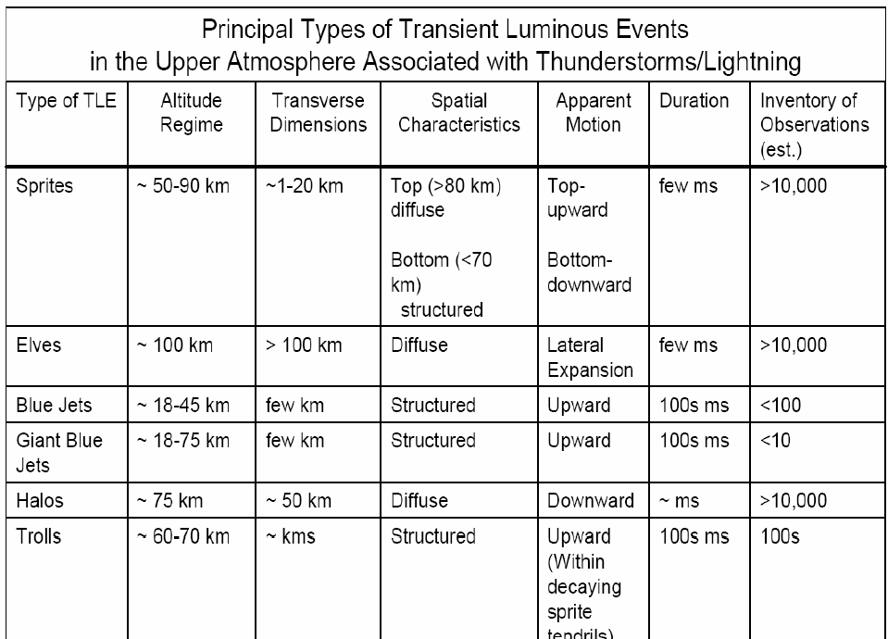

Slide 23
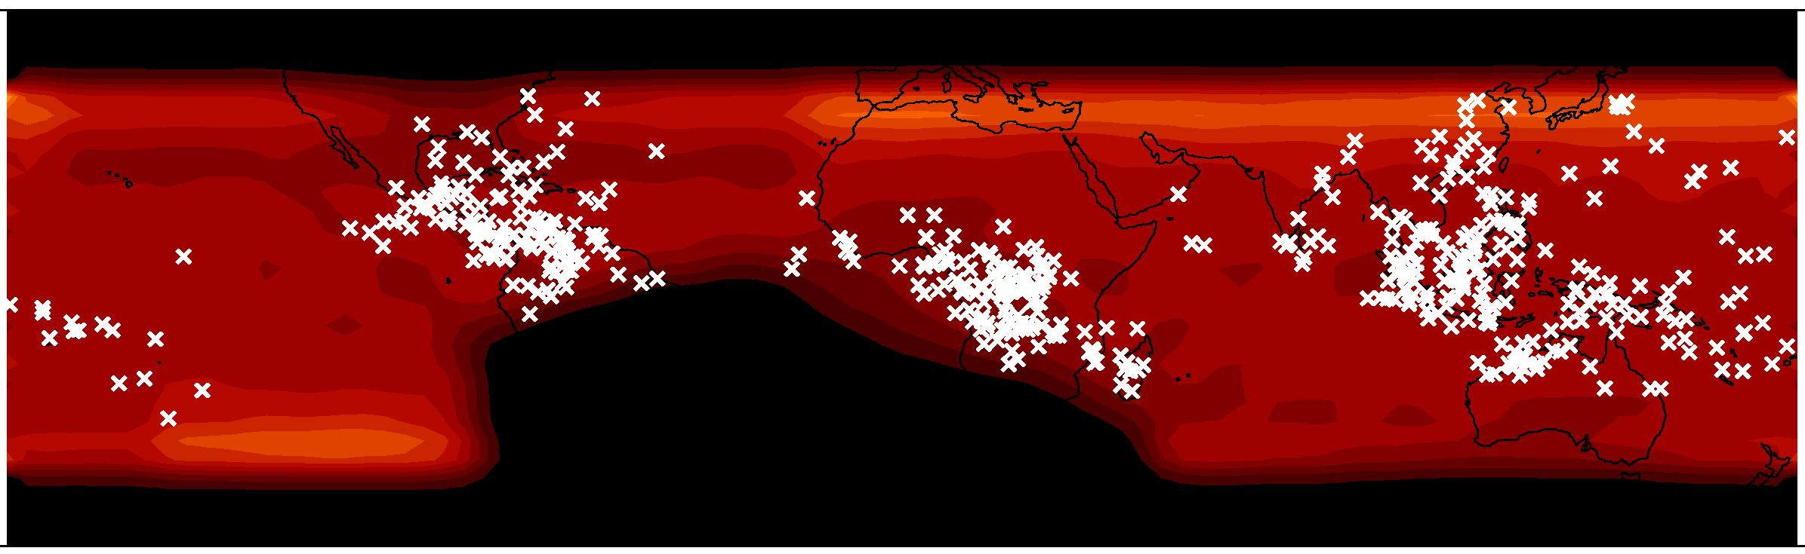
RHESSI : (Terrestrial Gamma Flashes TGFs)
498 events in 37 months
Smith et al., 2005

Slide 24
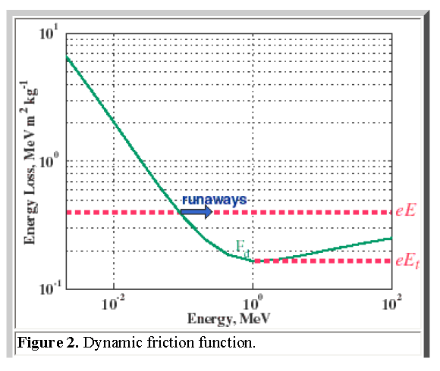

Slide 25
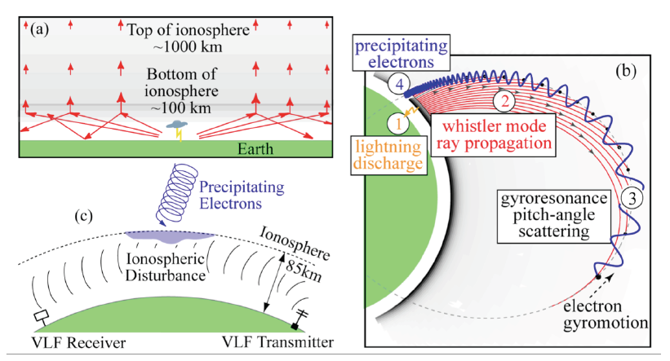
Interaction with radiation belt

Slide 26
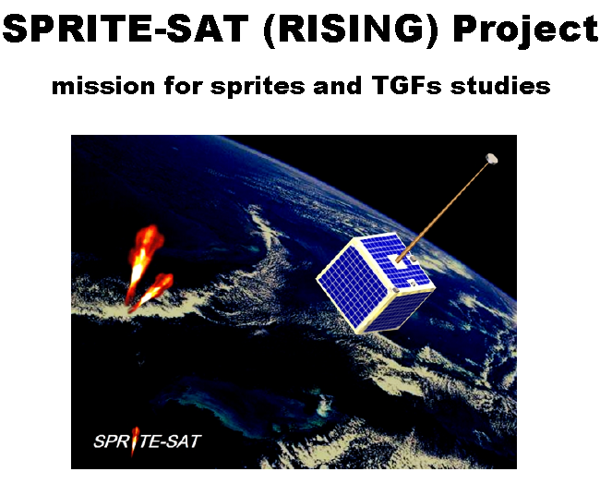
2009 TOHOKU UNIVERSITY

Slide 27

Tool for the Analysis of RAdiations
from lightNIngs and Sprites =TARANIS

Slide 28
THE ATMOSPHERIC-SPACE INTERACTION MONITOR

Slide 30
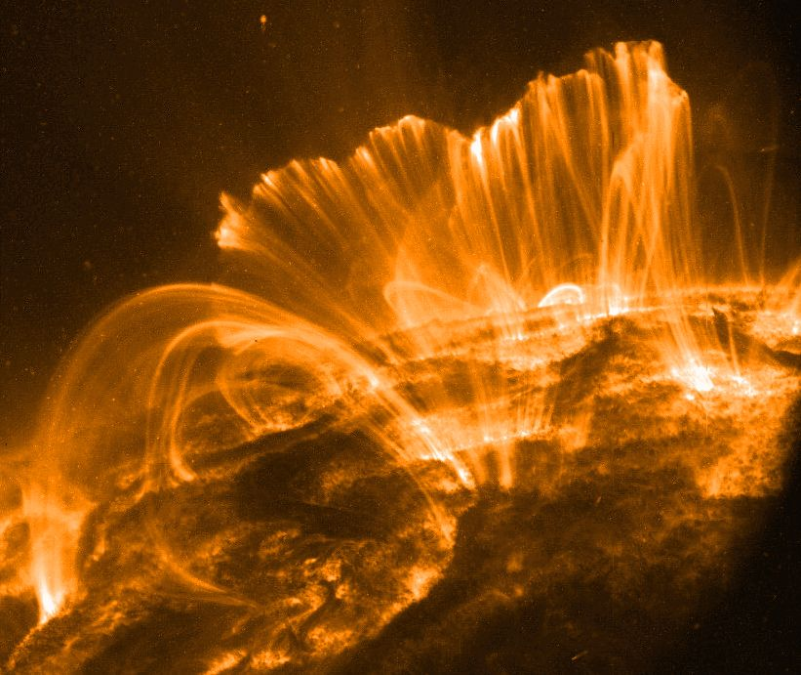
FILAMENTATION OF THE SPACE PLASMA

Slide 31
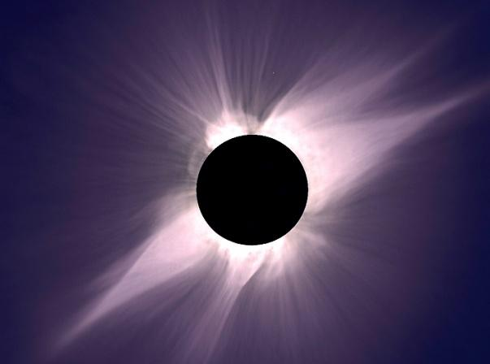

Slide 32
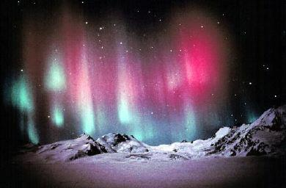

Slide 33
Field-Aligned Currents and Filaments in Space Plasmas
Filamentary strucures are found in the following space plasmas, all of which are observed or are likely to be associated with electric currents:
1.In the aurora filaments parallel to the magnetic field are often observed. These can have dimensions down to 100m.
2. Inverted V events (105 -106 A) and in situ measurements of the electric currents in the magnetosphere demonstrate the existence of the filamentary structures
3. In the ionosphere of Venus „flux ropes” or „magnetic ropes”, whose filamentary diameter are typically 20km, are observed.

Slide 34
4.In the Sun, prominences (1011A), spicules, coronal streamers, polar plumes etc. Show filamentary structure whose dimensions are in order 107-108m.
5.The cometary tails often have a pronounced filamentary structure.
6.In the interstelar medium and in the interstelar clouds there is a abundance of the filamentary structures.
7.The center of the Galaxy, where twisting plasma filaments, apparently held together by magnetic field possesing both azimutal and poloidal components, extend for nearly 60pc (1018 m.)

Slide 35
Physical Mechanisms of Filamentation
There are two fundamental physical mechanisms trying to explain a creation of the filamentary structure in the space plasmas. Both are associated with currents and ambient magnetic field.
1.Pinch instability of the field aligned electric current (Galperin et al. 1986)
2.Filament instability of the dispersive Alfven waves (Shukla and Stenflo 1989, Lavader et al. 2001)

Slide 36
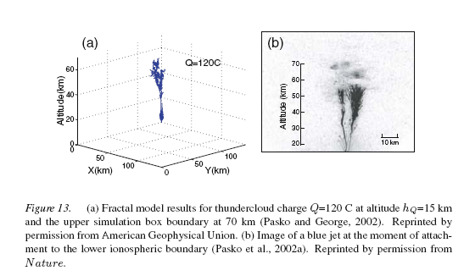

Slide 37
SUMMARY
The characteristics of the TLE’s have been described by different groups working with detectors on the orbit and on ground detecting systems.
JEM EUSO is unique in that its time and spatial resolution is very high and it will allow to see evolution in time of the subtle structure (filamentation) of TLE’s.
There will be two more experiments dedicated to measuring the TLEs on the orbit soon ASIM and Taranis.
The set of data produced by all these experiments may create an exceptional chance to further investigate the physical nature of the TLEs.

Slide 38
Synergies possibles
Sciences de l’atmosphère
TLEs (sprites, jets, elves, halos…)
Couverture nuageuse
Autres ?
Sciences de l’océan ?
Bioluminescence de surface
Autres ?
Sciences des météorites
Statistique, Trajectoires, etc.
Autres ?

Slide 39
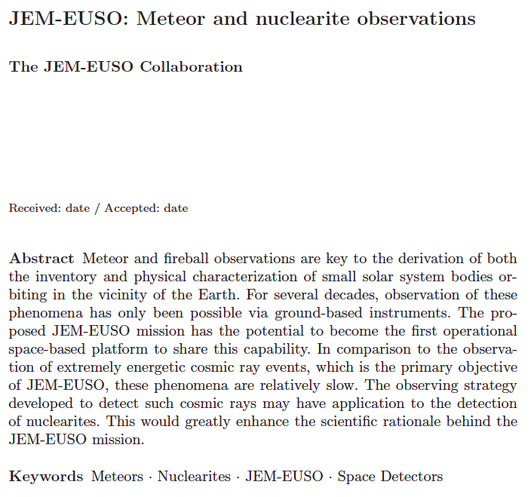

Slide 40
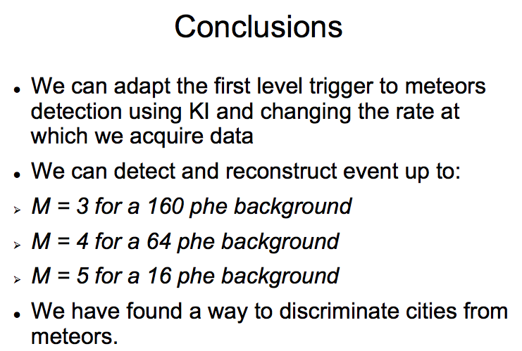

Slide 41
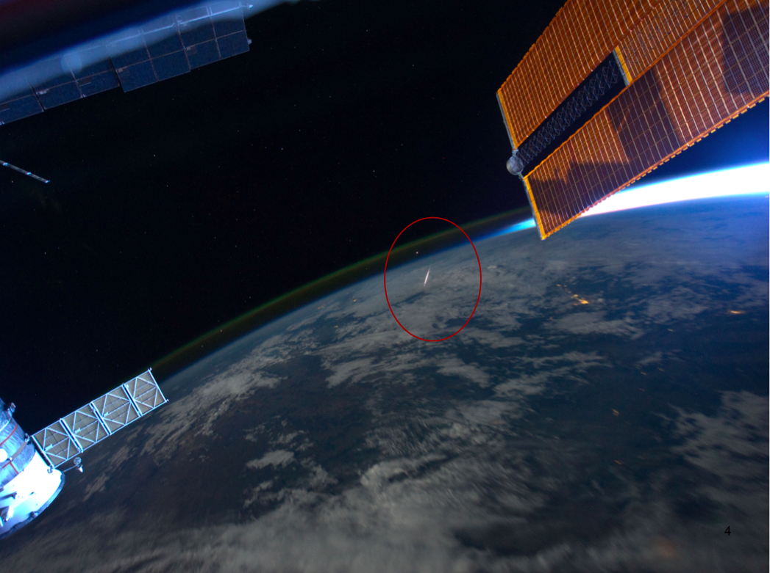

Slide 42
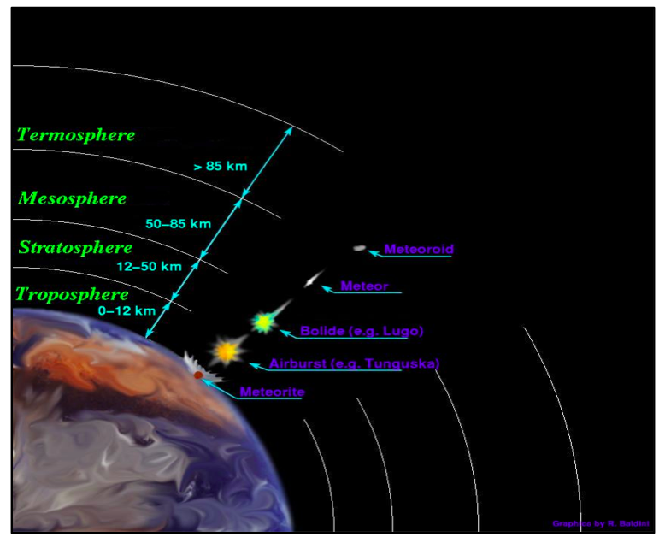

Slide 43
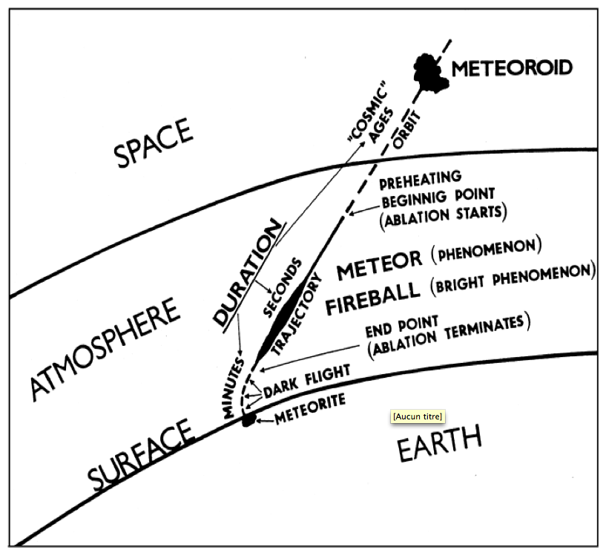

Slide 44
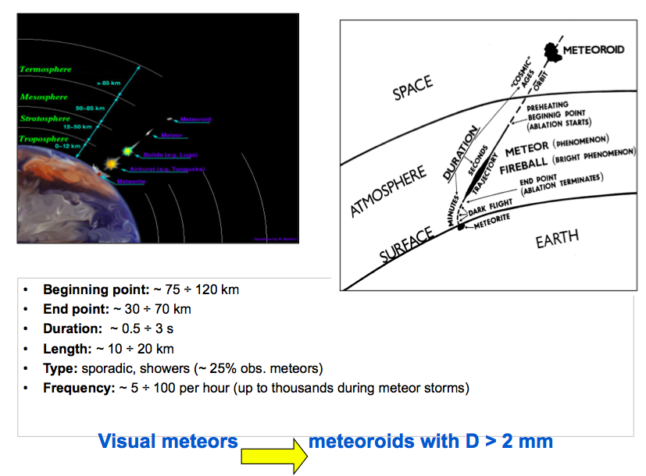

Slide 45
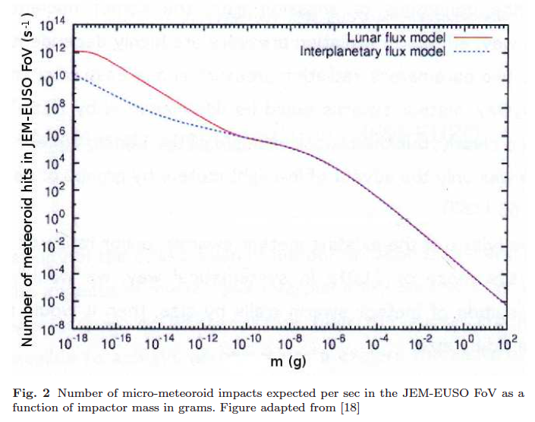

Slide 46
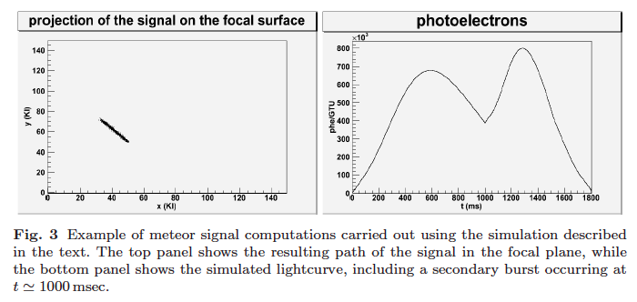

Slide 47
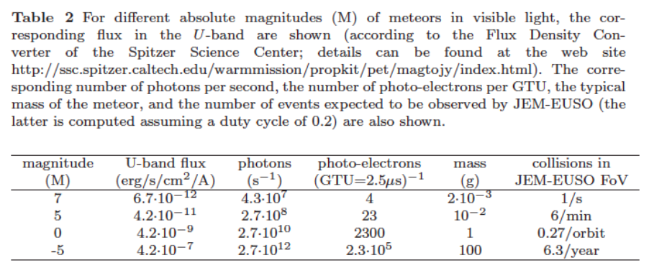

Slide 48
Récupération de météorites
Détermination de la trajectoire des météorites avec JEM-EUSO
Déterminer la zone d’impact des corps atteignant le sol
→ récupération avant “pollution” par l’environnement terrestre !
Connaissance des comètes
Distribution de vitesse très différentes pour les météorites associées aux comètes
Question: taille maximale des « débris » de comète ?
→ Inconnu, mais important !

Slide 49
Synergies possibles
Sciences de l’atmosphère
TLEs (sprites, jets, elves, halos…)
Couverture nuageuse
Autres ?
Sciences de l’océan ?
Bioluminescence de surface
Autres ?
Sciences des météorites
Statistique, Trajectoires, etc.
Autres ?

