Slide 1
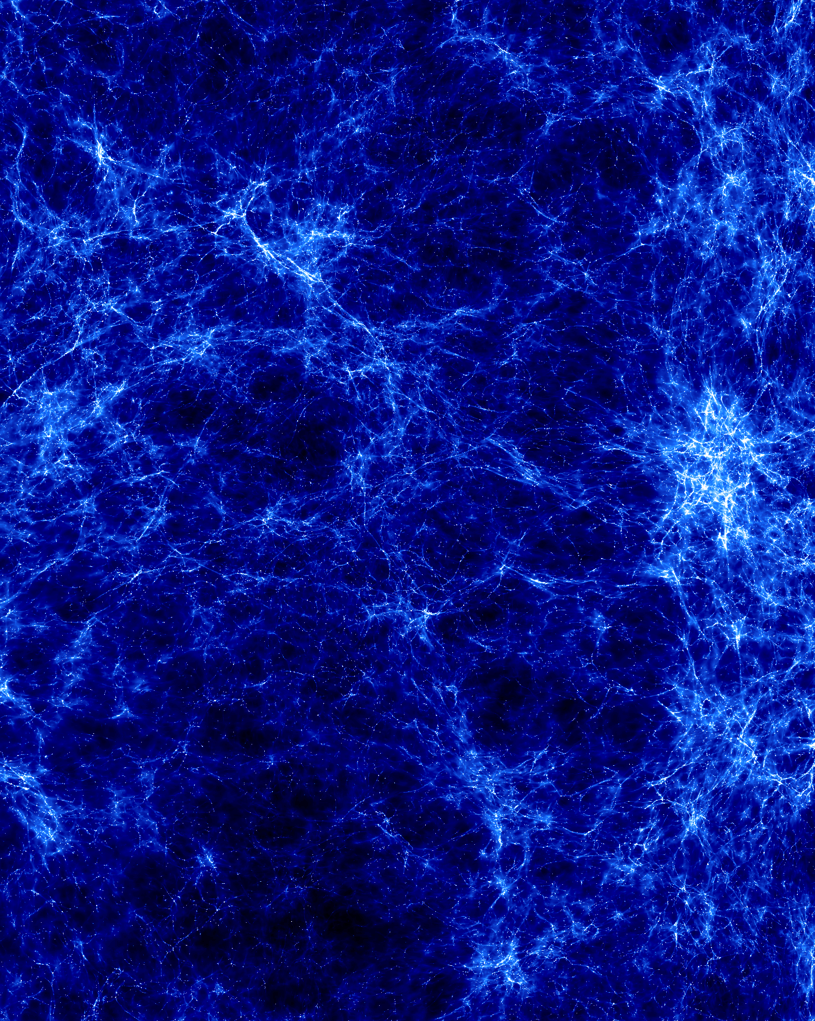
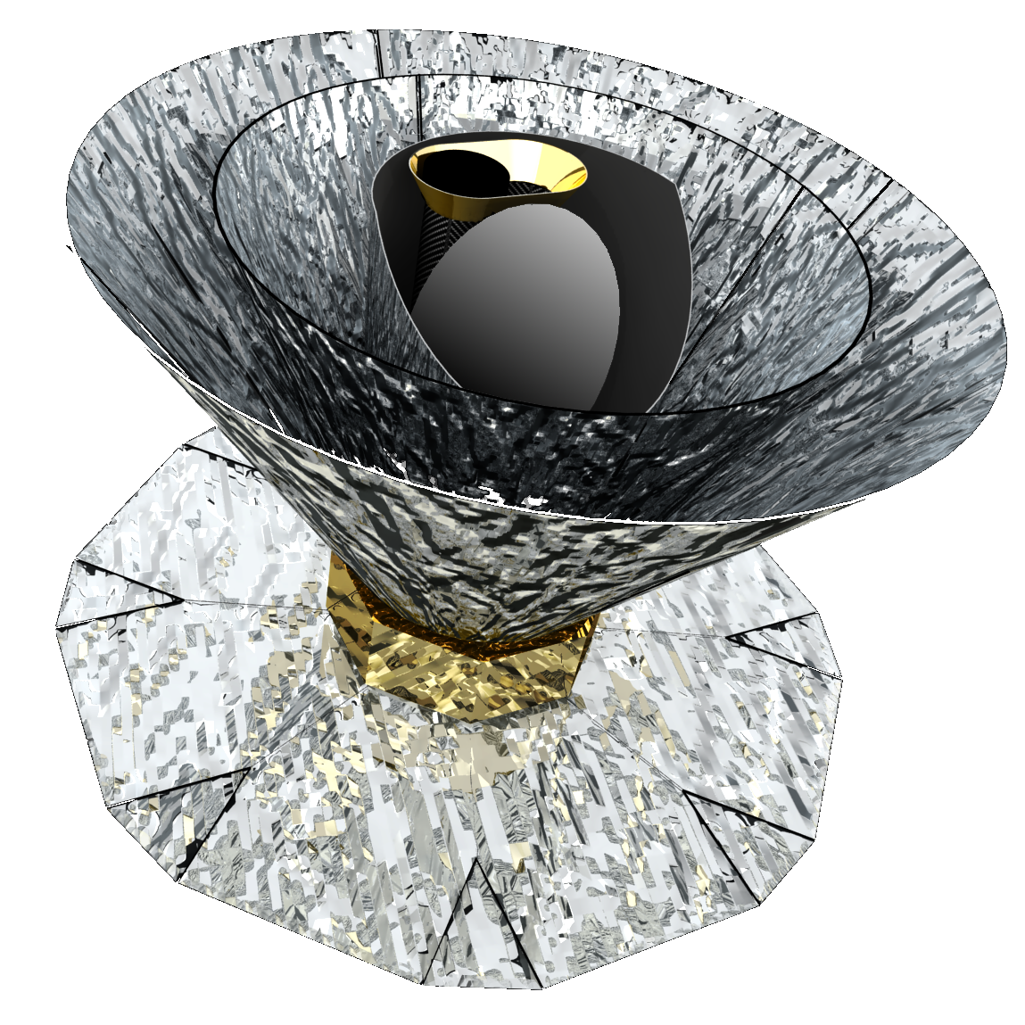
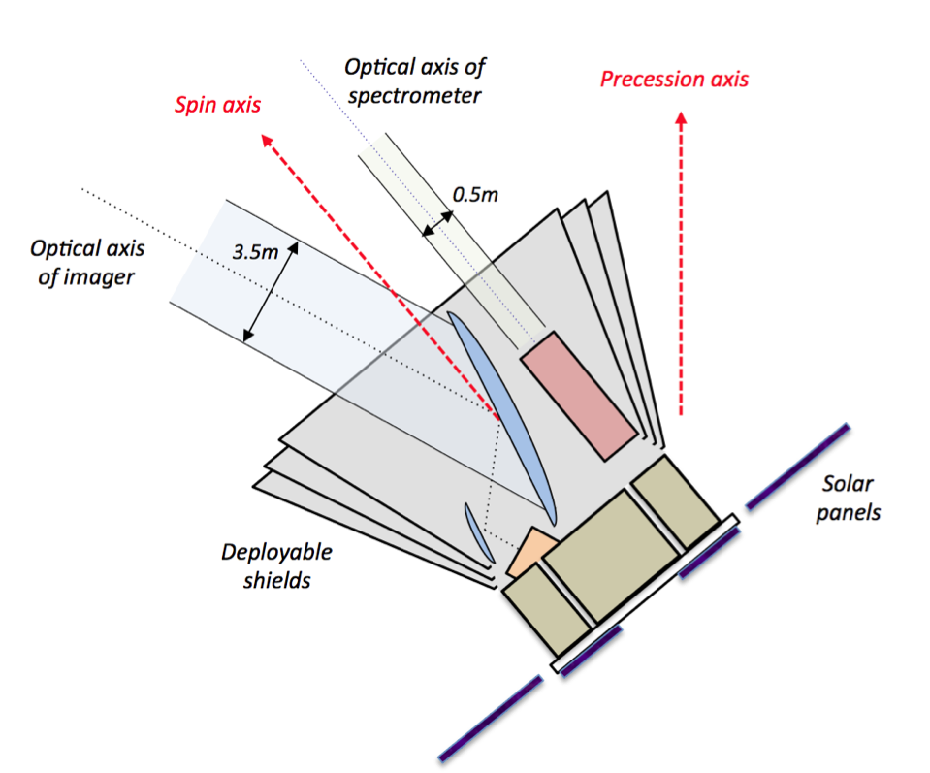
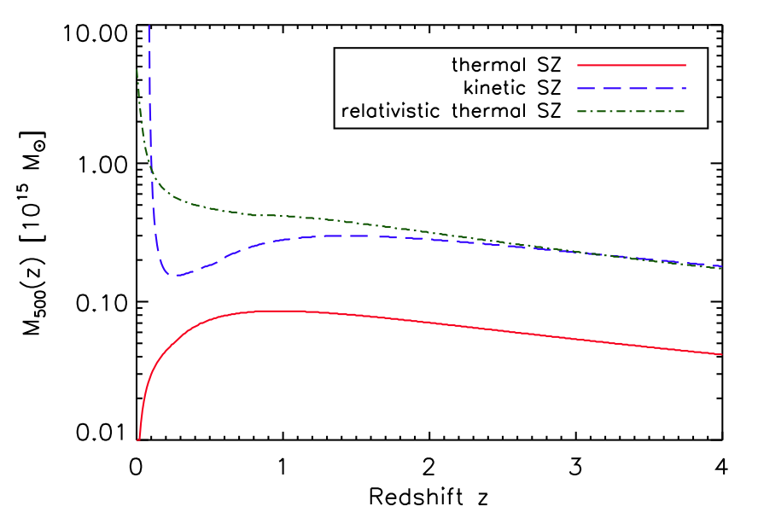
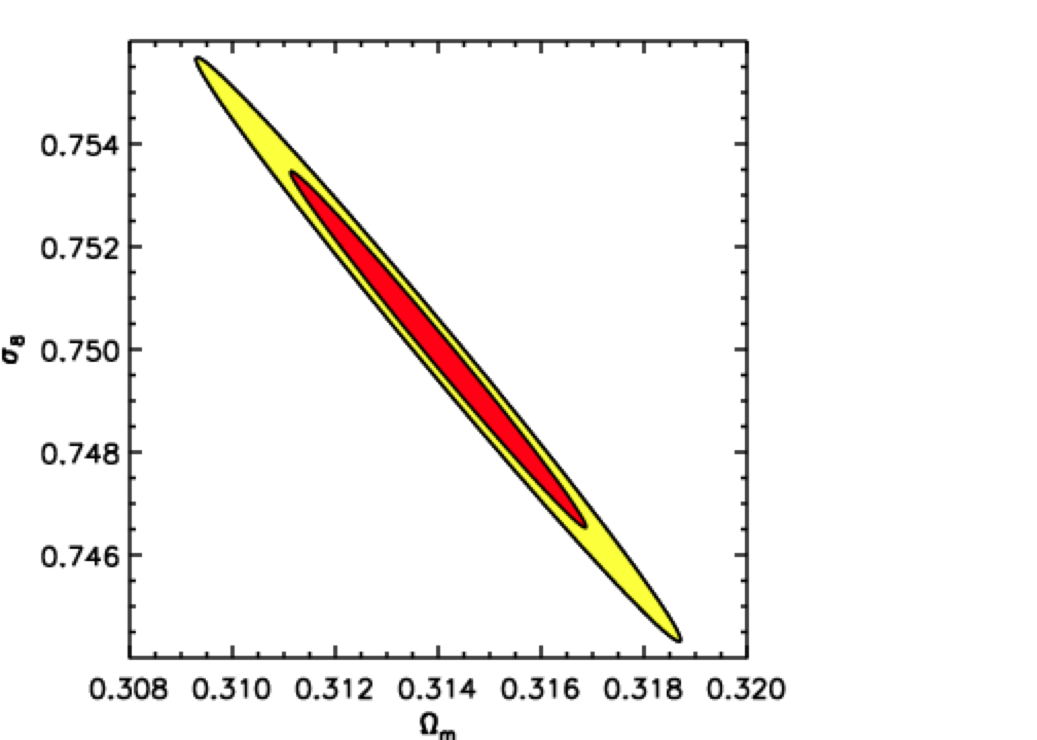
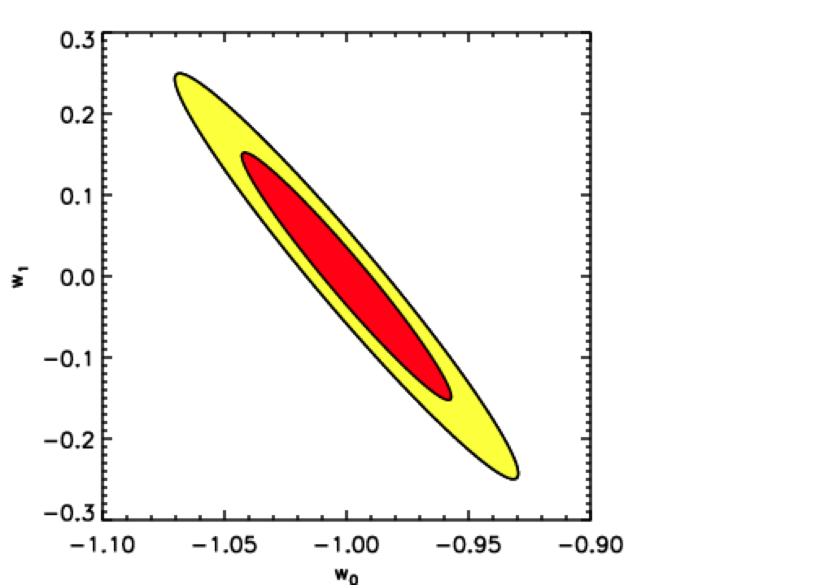
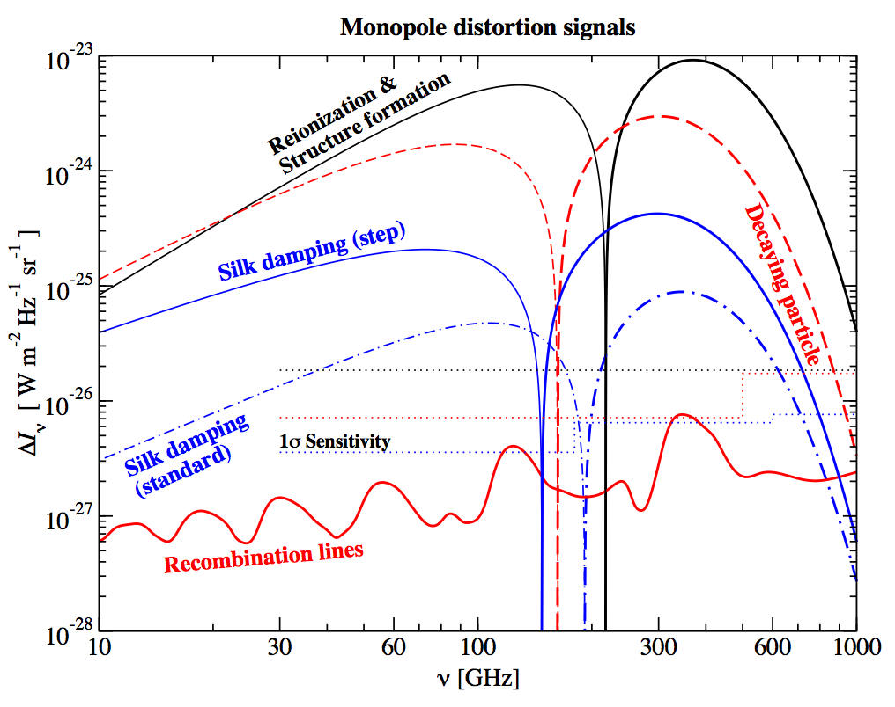
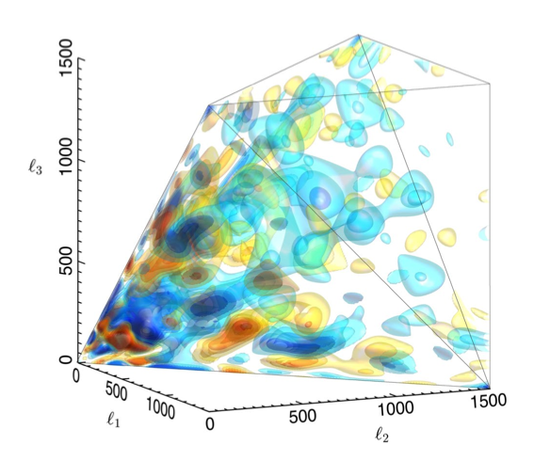
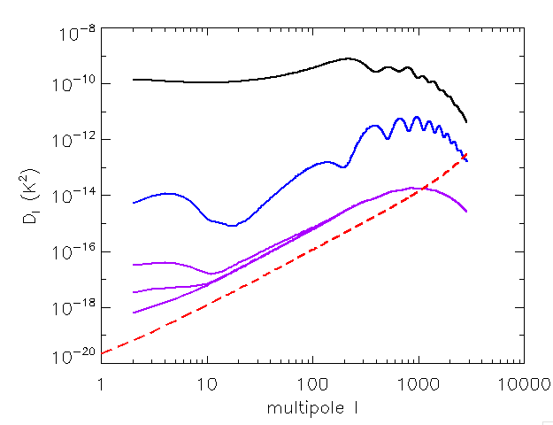
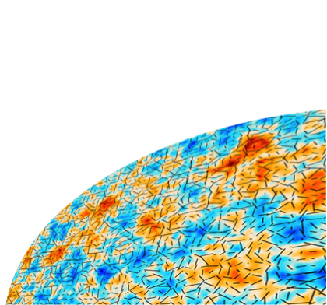
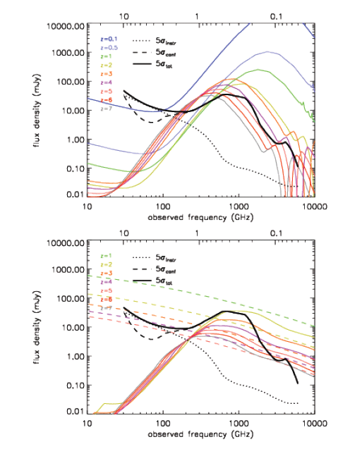
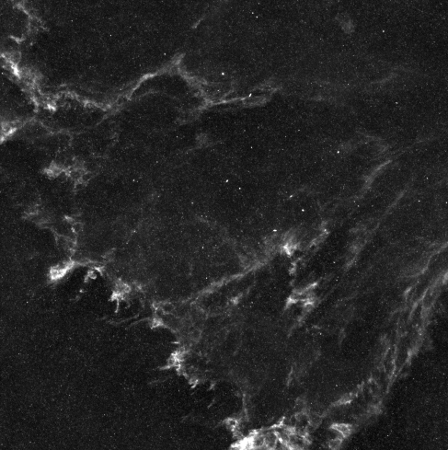
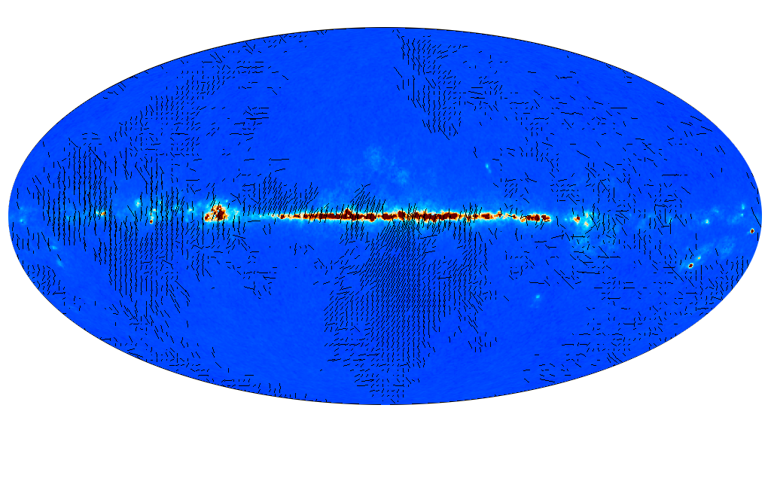
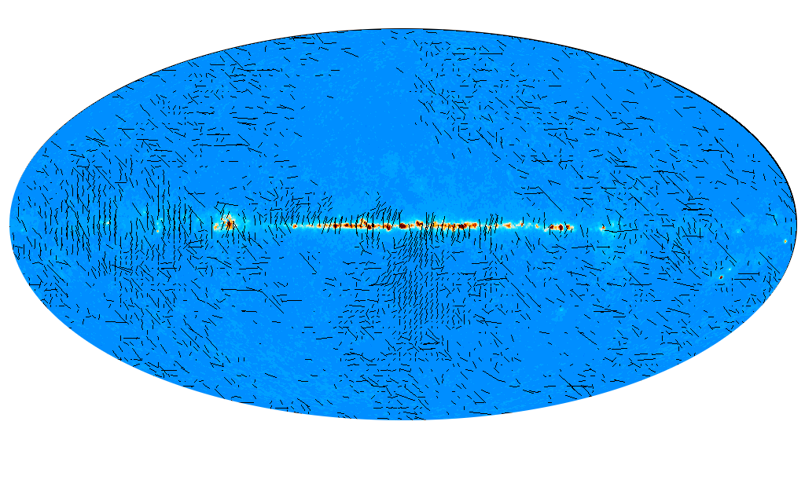
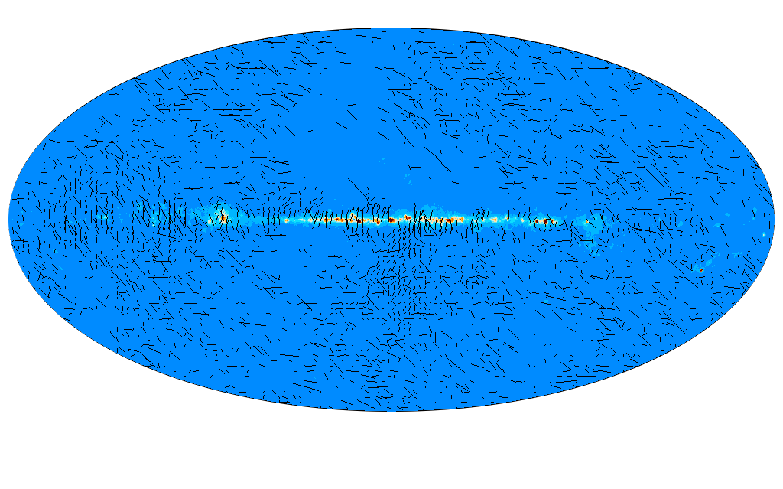
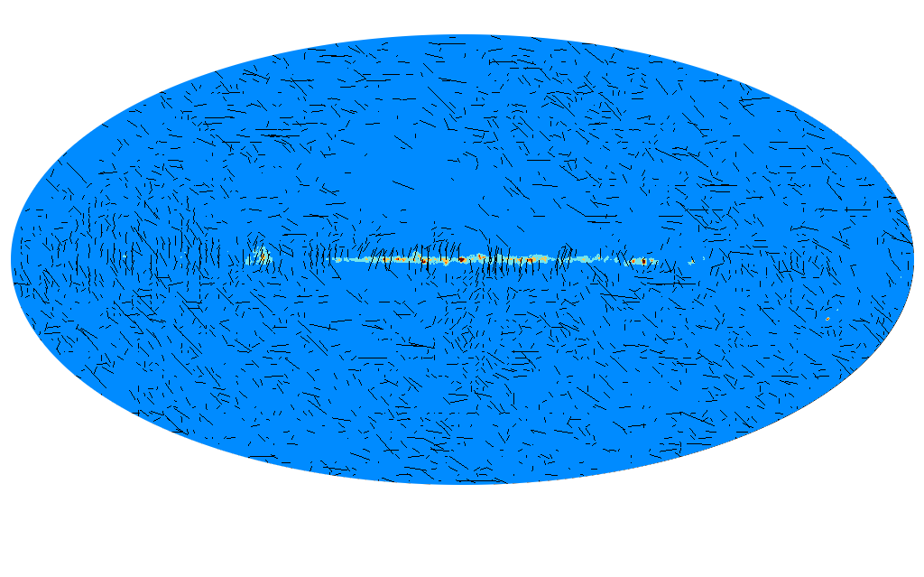
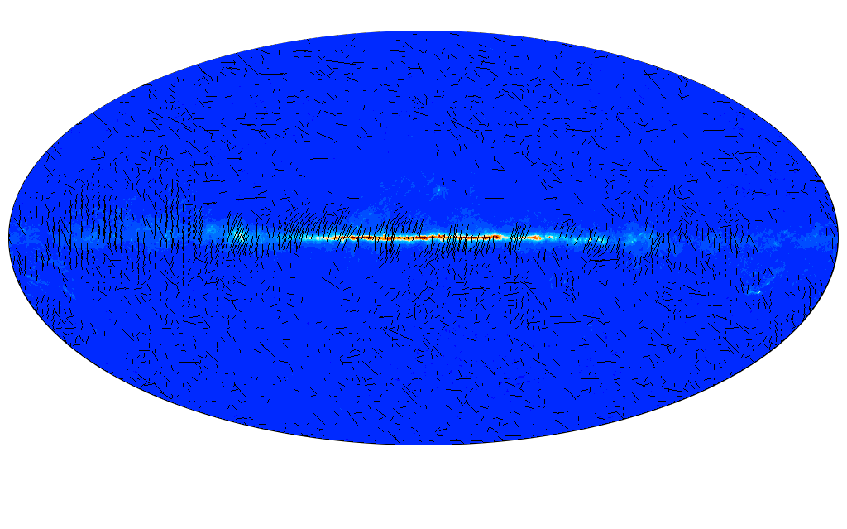
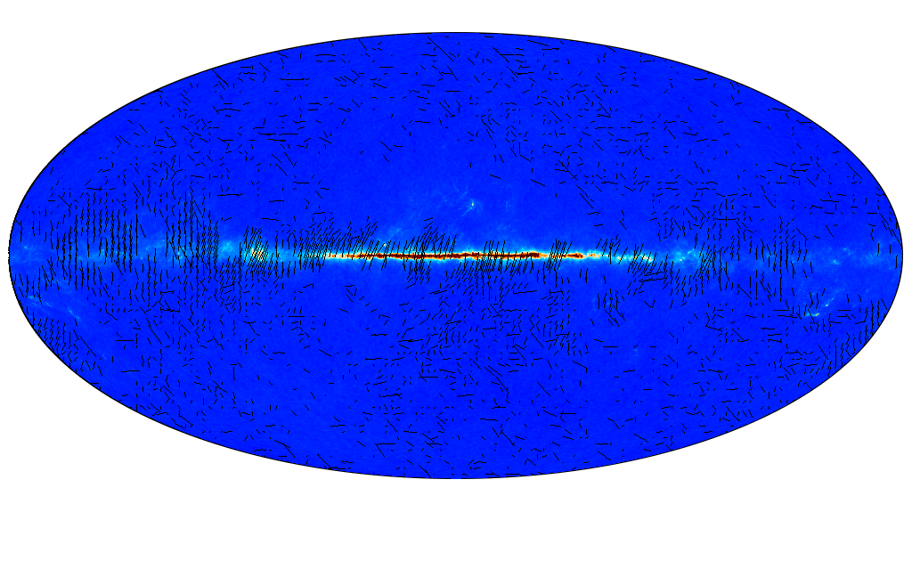
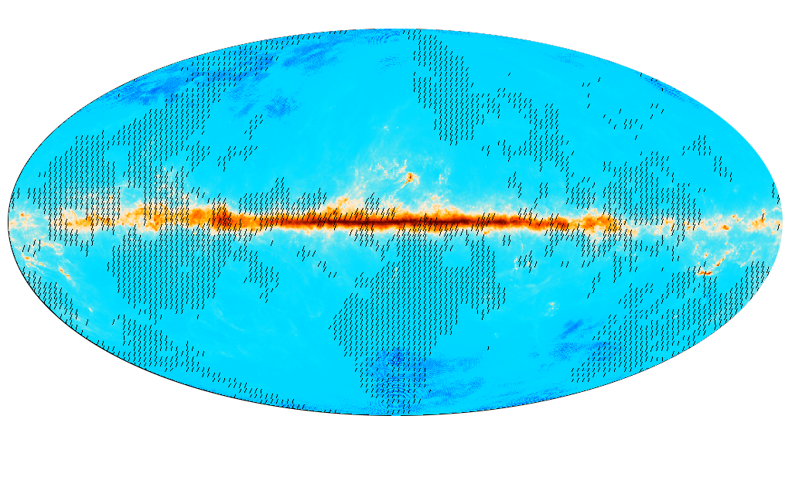
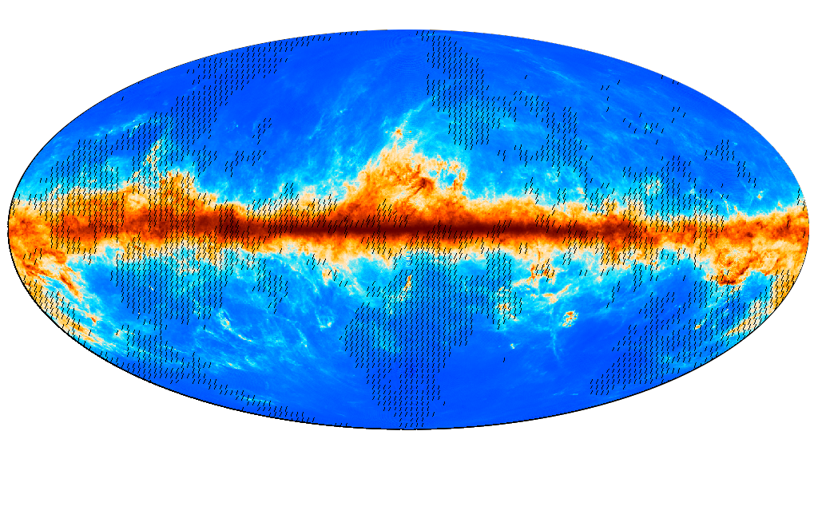
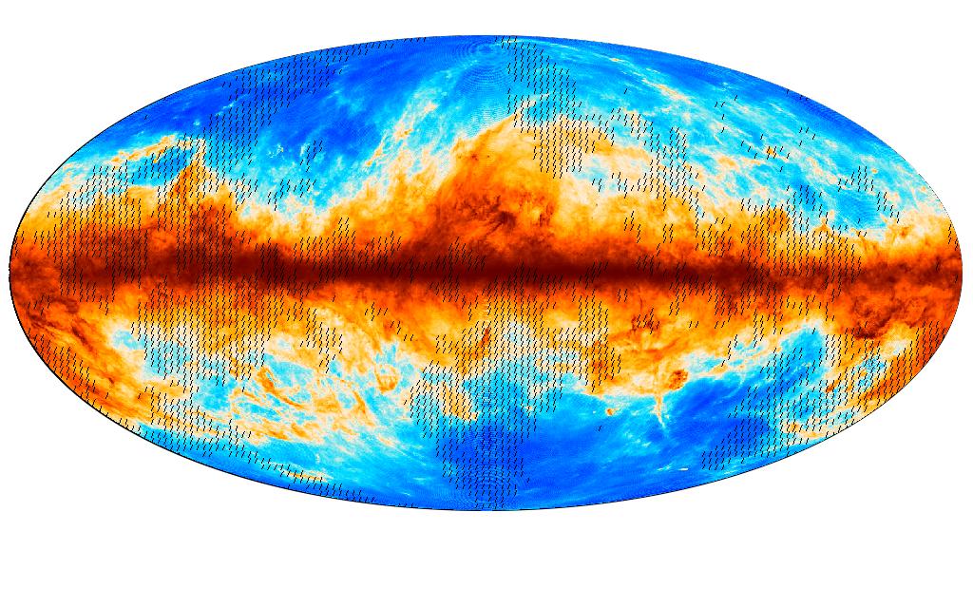
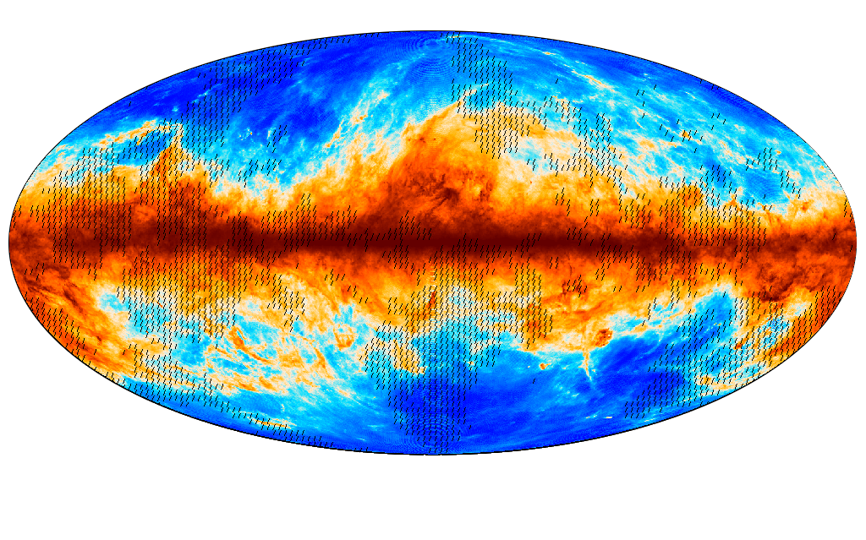
Probing cosmic structures and radiation with the ultimate polarimetric spectro-imaging of the microwave and far-infrared sky
PRISM
PRISM is an L-class mission proposed to answer the 2013 ESA call for scientific themes for the L2 and L3 missions. PRISM will map the absolute emission and polarization of the sky in the far-IR/mm range with unprecedented sensitivity and resolution. Its high resolution (from a few arcseconds to a few arcminutes, depending on frequency) and exquisite sensitivity will enable breakthroughs in many areas of astrophysics and fundamental science.
The Galactic ISM
PRISM will address three fundamental questions in Galactic astrophysics: 1- What processes determine the structure of the interstellar medium? 2- What role does the magnetic field play in star formation? 3- What processes determine the composition and evolution of the interstellar dust?
PRISM will extend the Herschel dust observations to the whole sky and to polarization. It will also map the main emission lines which are key to quantifying the physical processes of the ISM.
The mission
PRISM will cover the 30 GHz – 6 THz frequency range with two instruments:
A polarimetric imager with thousands of pixels covering 30 broad (dν/ν≈0.25) and 300 narrow (dν/ν≈0.025) diffraction limited bands. Its sensitivity will be limited by photon noise, minimized by cooling the 3.5 m telescope to 4 K. Its optical axis will be offset from the spin axis by 30°.
An absolute spectrometer cooled to 2.7 K, with an angular resolution of 1.4°,
and both high- and low-spectral resolution observing modes (Δν≈0.5 GHz
and 15 GHz respectively). Its optical axis is aligned with the spin axis.
The platform will orbit around the second Sun-Earth Lagrange point.
The sky scanning will be obtained with a combination of: 1) spinning with a
10-second period; 2) precession of the spin axis on a 45° cone; 3) drift of the
precession axis (1°/day to maintain an anti-solar orientation) to provide
optimally cross-linked full-sky coverage.
A companion satellite will provide a high-gain pointing antenna for high data-rate
telemetry and calibrators for in-flight beam and polarization mapping.
Polarized
Radiation
Imaging and Spectroscopy
Mission
Galaxy clusters
Using the Sunyaev-Zeldovich (SZ) effect, the imager will detect all the galaxy clusters in the observable universe with mass above ≈10¹⁴ M, and many more below – in total, more than 10⁶ clusters. This will place tight constraints on cosmological models and structure formation.
The cosmic velocity field will be measured with the kinetic SZ effect, with typical errors of 50 km/s for individual clusters.
Inflation
PRISM will study inflation in several ways:
PRISM will detect B-modes near the ideal instrument limit.
PRISM will measure CMB lensing with high accuracy in both polarization and temperature, probing the neutrino mass hierarchy and separating primordial and lensing B-modes.
PRISM will also probe the Planck era with high precision measurements of bi-spectra and tri-spectra of the CMB map.
5σ limits
CMB spectral distortions
The absolute spectrometer will improve significantly over FIRAS, both in angular resolution and in sensitivity. It will measure
y-distortions from energy injections at redshifts < 10⁴, as well as from hot galaxy clusters;
μ-distortions and more general spectral distortions, which have the potential to uncover decaying dark matter;
spectral distortions that will probe the primordial power spectrum on very small scales.
EE
TT
r = 10⁻²
BB
r = 10⁻³
PRISM
r = 10⁻⁴
PRISM will provide hundreds of intensity and polarization maps – a vast legacy archive useful for almost all branches of astronomy for decades to come. Combining low resolution spectrometer data and high resolution full-sky polarized maps, PRISM will deliver a full spectro-polarimetric survey of the complete sky from 50 μm to 1 cm.
Legacy
CIB and LSS
Emission from high-redshift, star forming, dusty galaxies constitutes the cosmic infrared background (CIB) which PRISM, owing to its high sensitivity, angular resolution, and sky coverage in the far infrared, will be uniquely able to investigate. These measurements will uncover the details of star formation in the early Universe.
Cross-correlation of the CMB lensing, of galaxy clusters, of far-infrared emission seen by PRISM, and of objects detected in other surveys will provide invaluable new information on the Universe at high-redshift, on the formation of large scale structure (LSS) and on the 3-D distribution of matter in the entire observable Universe.
…
…
…
…
60 GHz
180 GHz
…
Visit http://www.prism-mission.org and sign
up to join the team and support the mission
1200 GHz
…
…

